Slide 1
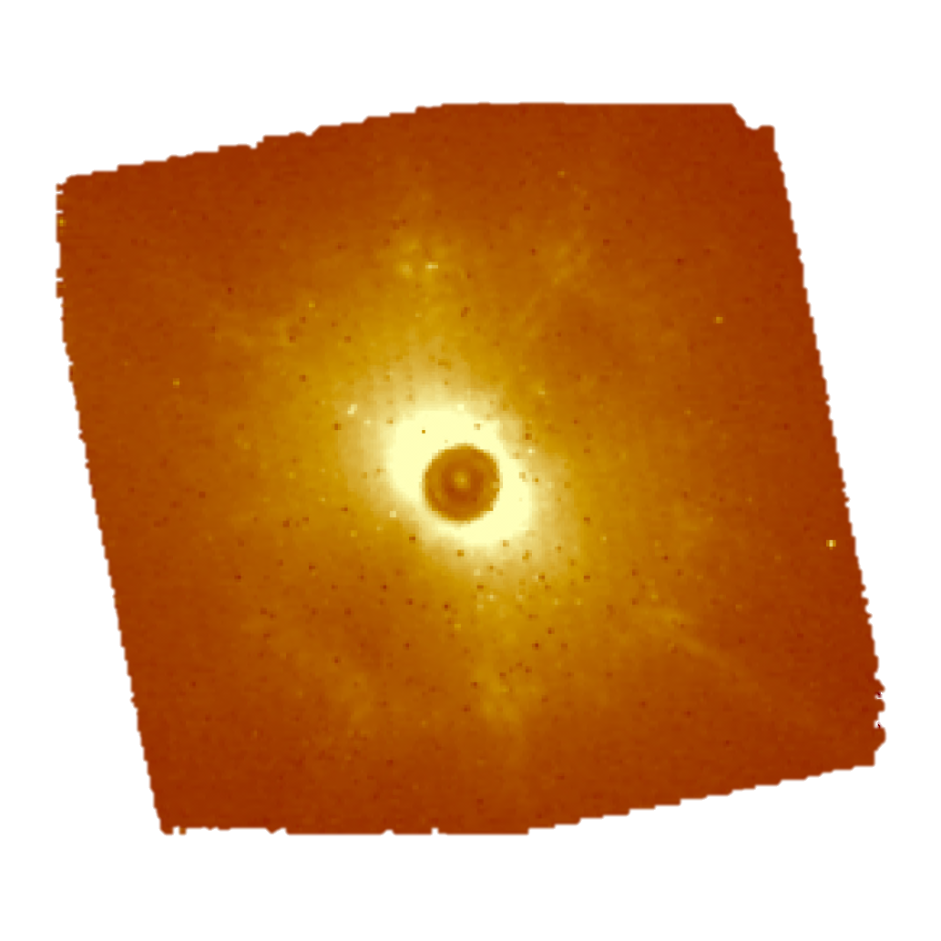
Workshop 2017 – 11/10/2017
Protoplanetary discs observations with ALMA and SPHERE"
Maria Giulia Ubeira Gabellini
PhD student at ESO and at the University of Milan
Supervisors: G. Lodato (UniMi), M.E. van den Ancker (ESO)
Collaborators: D. Fedele (Arcetri), C.F. Manara, L. Testi, A. Miotello, S. Facchini
Notes:
Let’s first introduce myself: I am Maria Giulia and I am doing my PhD both here and at ESO in Germany, I will describe you the work I have done so far, concentrating on two projects: both are in the field of planet formation and in particular are addressing the question of how planets can form from a disc of dust and gas.

Slide 2
Workshop 2017 – 11/10/2017
Protoplanetary discs formation:
A dense molecular cloud collapses under its own gravity
Due to its initial rotation, forms a disk which carries most of the angular momentum of the primordial nebula
The disk slowly accretes onto the central star and forms eventually planets.
Image from Andre (2002)
Maria Giulia Ubeira Gabellini 1
Notes:
I will describe you the general framework behind my work. A spherical molecular cloud is collapsing under his own gravity. Due to his initial rotation it collapse and form a disc. This disc begin to accrete into the central star and it is at this stage that the planet formation can occur. On the right you can see the Spectral Energy Distribution related to each stage of the formation. I will concentrate mainly to the two last steps.
One of the main goals of current planet-formation studies is to find planets still embedded in a proto-planetary disc, in order to catch the planet formation process as it happens.

Slide 3

Workshop 2017 – 11/10/2017
TARGET PROPERTIES
CQ Tau:
young (5Myr)
nearby (d =160 pc)
intermediate mass ($M_{∗}$ = 1.5 $M_{sun}$)
$L_{∗}$ = 16.9 $L_{sun}$
$T_{∗}$= 6900 K
Presence of an inner cavity in the disk dust distribution.
Evidence of a massive planet candidate just outside the outer edge of the cavity as imaged with ALMA (Thanks to an excellent LBTI/L-band dataset)
Maria Giulia Ubeira Gabellini 2
Notes:
In the first project, I have been working on one specific target. It is called CQ tau, it is young, nearby ecc. The peculiarities of this system is that it has a cavity in gas and dust and there are evidences of a massive planet candidate just outside the gap, thanks to the excellent LBTI/L-band (?) dataset.
Knowing this some questions can immediately coming up: what are the profiles in dust and gas? And if this planet can be responsible for creating such a gap.

Slide 4
Workshop 2017 – 11/10/2017
TARGET PROPERTIES
CQ Tau:
young (5Myr)
nearby (d =160 pc)
intermediate mass ($M_{∗}$ = 1.5 $M_{sun}$)
$L_{∗}$ = 16.9 $L_{sun}$
$T_{∗}$= 6900 K
Presence of an inner cavity in the disk dust distribution.
Evidence of a massive planet candidate just outside the outer edge of the cavity as imaged with ALMA (Thanks to an excellent LBTI/L-band dataset)
?
What are the dust and gas profiles? Can a planet be responsible to clear the distribution of gas and dust in such a way?
Maria Giulia Ubeira Gabellini 2
Notes:
In the first project, I have been working on one specific target. It is called CQ tau, it is young, nearby ecc. The peculiarities of this system is that it has a cavity in gas and dust and there are evidences of a massive planet candidate just outside the gap, thanks to the excellent LBTI/L-band (?) dataset.
Knowing this some questions can immediately coming up: what are the profiles in dust and gas? And if this planet can be responsible for creating such a gap.

Slide 5
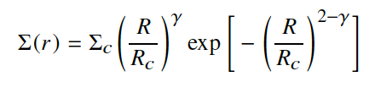

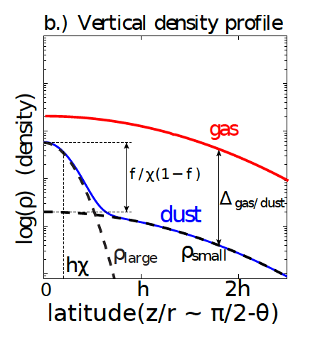
Workshop 2017 – 11/10/2017
We have studied the dust and gas distribution around pre-main-sequence stars using the Atacama Large Millimeter Array (ALMA).
We used the physical-chemical modeling tool DALI (Bruderer 2013): solves for the chemical structure, the radiative transfer and the thermal balance within the disk.
Radial profile
Vertical profile
Ref. DALI manual
Ref. Trapman et al. 2017
Maria Giulia Ubeira Gabellini 3
Notes:
We have been studied the dust and gas distribution of data taken with ALMA and we used a physical-chemical model called DALI to model such a disc. We used this equation to model the radial and vertical profiles. Each parameter was varied in order to find the best representative model.

Slide 6
Workshop 2017 – 11/10/2017
Our data include the thermal continuum produced by cold dust, and line emission maps in different isotopologues of the CO molecule (12CO, 13CO and C18O), that need to be considered simultaneously.
We focused on finding the best model’s parameters to model the high angular resolution observations of the protoplanetary disk.
1) Spectral Energy Distribution (SED)
2) Dust Continuum at 1.3 mm
Maria Giulia Ubeira Gabellini 4
Notes:
Our data include the continuum produced mainly by large grains of dust and line emission maps of CO isotopologues. The model found have to describe simultaneously all of these profiles. First of all we concentrate in finding the best representative model for the Spectral Energy Distribution which probes the behavior of the disc vertical distribution mainly considering small grains. Whereas the dust continuum at 1.3 micron, probes the distribution of large grains on the radial distribution of the disc. Once we were happy with these profiles, we concentrate on the CO lines.

Slide 7

Workshop 2017 – 11/10/2017
12CO: main isotopologue, only traces the surfaces of protoplanetary disks (optically thick at low column densities);
13CO and C18O: less-abundant CO isotopologues, optically thick much deeper and trace the gas down to the midplane of the disk.
12CO
C18O
13CO
Maria Giulia Ubeira Gabellini 5
Notes:
H2 is the more abundant gas, but it is really hard to detect. Whereas the second more abundant one is the CO with his isotopologues, which is possible to see thanks to the capabilities of ALMA. 12CO is important to probe the temperature of the disc, but not the total amount of the gas content. It is indeed, optically thick. C18O is instead optically thin and can probe down to the bulk of the disc. We used this one in order to find the Sigma gas, amount of gas inside the disc. 13CO is partially optically thin and thick so is the one more difficult to deal with. The different lines are the same model, with a different dimension or depletion of the cavity. There is indeed a degenerancy of these parameters.

Slide 8



Workshop 2017 – 11/10/2017
Results:
We modelled CQ tau as a disk where there is a sharp ring of dust (just outside the supposed planetary orbit) and a broader extent of the gas.
Dust has a larger cavity than gas.
LARGE DUST
GAS
$R_{C}$ = 56 AU
$h_{C}$ = 0.075
$ψ$ = 0.1
$Σ_{gas}$ = 0.7
$γ$ = -0.7
$R_{cav}$ = 32 AU
$Δ_{GAS}$ = ${10}^{−2}$
$R_{C}$ = 56 AU
$h_{C}$ = 0.075
$ψ$ = 0.1
$Σ_{gas}$ = 2.5
$γ$ = 0.3
$R_{cav}$ = 15-25 AU
$Δ_{GAS}$ = ${10}^{−1}$-${10}^{−3}$
SMALL DUST
$Δ_{small}$= 0.015
Maria Giulia Ubeira Gabellini 6
Notes:
Here the results. We found a sharp ring of dust and a broader extent of gas. The cavity of gas and dust are different, the dust has a bigger cavity than the gas. We have just started hydrodynamic simulations to address if the disk structure could be influenced by the planetary candidate.
Here the profiles found. Black is the gas, with has the same profile of small dust with a depletion of a factor Delta small. And the large grains in red.

Slide 9
Are All Group I Disks Transitional? Workshop 2017 – 11/10/2017
?
What is the geometry of the circumstellar material around intermediate-mass pre-main-sequence stars? Are All Group I Disks Transitional?
Maria Giulia Ubeira Gabellini 7
Notes:
We want to understand what is the geometry of such disks and what is the difference between group I and group II sources. For what we know group I has a strong excess from the near to the far IR, whereas group II has still a strong near IR excess but a much weaker far-IR excess.
There were some models coming up: the one of Meeus 2001 which is describing the group II sources as in the upper part of the left figure: the inner part of the disk is optically thin and allow radiation to heat the external part of the disk, leading a flared disk; whereas group I have an optically thick inner disk which prevent the outer part from flaring.
Based on a study of silicate emission features, Maaskant et al. (2013) suggested that the SED of group I HAeBe stars can also be explained by inferring the presence of a large gap in their disk and can be characterized as (pre-) transitional. An evolutionary path from the observed group I to the observed group II sources seems no longer likely. Instead, both might derive from a common ancestor.
I have developed a new method to get high contrast images from SPHERE-IFS data. Our target are nearby Herbig Ae/Be stars (intermediate-mass pre-main-sequence stars).
----------
Classified the Herbig Ae/ Be stars into two groups: group I sources, which require blackbody components up to far-infrared wavelengths to fit the SED, and group II sources, which can be well fitted with only a single power law at mid- to far-infrared wavelengths.

Slide 10
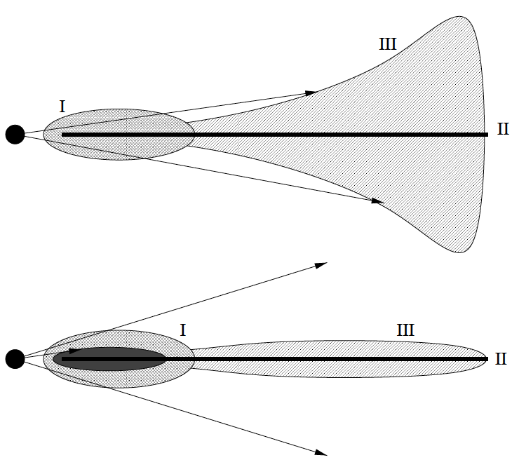
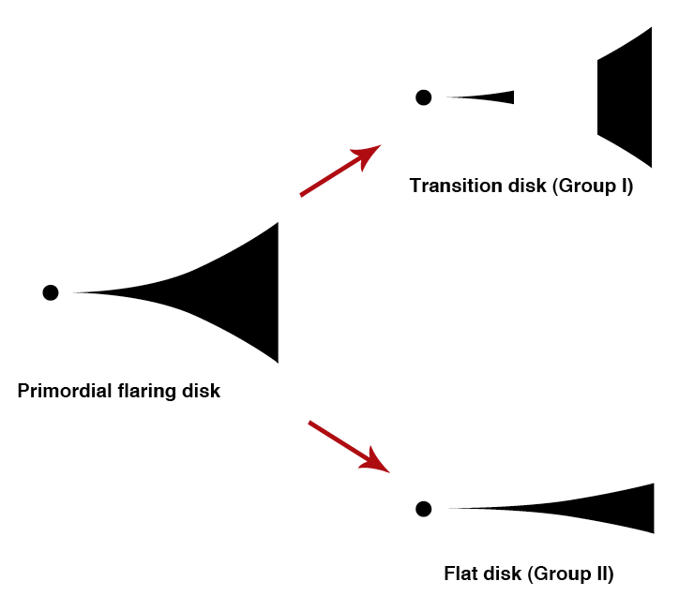

Are All Group I Disks Transitional? Workshop 2017 – 11/10/2017
?
What is the geometry of the circumstellar material around intermediate-mass pre-main-sequence stars? Are All Group I Disks Transitional?
The HAeBe (2-8 $M_{sun}$) sources can be divided in:
group I: strong near- to far-IR excess;
group II: strong near-IR excess and much weaker far-IR excess.
Group II
Group I
Meeus 2001
Maaskant 2013
group II : the inner part is optically thin.
group I: the inner part is partially optically thick and prevents the disc from flaring
group I: the SED can be explained by inferring the presence of a large gap in their disk
Maria Giulia Ubeira Gabellini 7
Notes:
We want to understand what is the geometry of such disks and what is the difference between group I and group II sources. For what we know group I has a strong excess from the near to the far IR, whereas group II has still a strong near IR excess but a much weaker far-IR excess.
There were some models coming up: the one of Meeus 2001 which is describing the group II sources as in the upper part of the left figure: the inner part of the disk is optically thin and allow radiation to heat the external part of the disk, leading a flared disk; whereas group I have an optically thick inner disk which prevent the outer part from flaring.
Based on a study of silicate emission features, Maaskant et al. (2013) suggested that the SED of group I HAeBe stars can also be explained by inferring the presence of a large gap in their disk and can be characterized as (pre-) transitional. An evolutionary path from the observed group I to the observed group II sources seems no longer likely. Instead, both might derive from a common ancestor.
I have developed a new method to get high contrast images from SPHERE-IFS data. Our target are nearby Herbig Ae/Be stars (intermediate-mass pre-main-sequence stars).
----------
Classified the Herbig Ae/ Be stars into two groups: group I sources, which require blackbody components up to far-infrared wavelengths to fit the SED, and group II sources, which can be well fitted with only a single power law at mid- to far-infrared wavelengths.

Slide 11
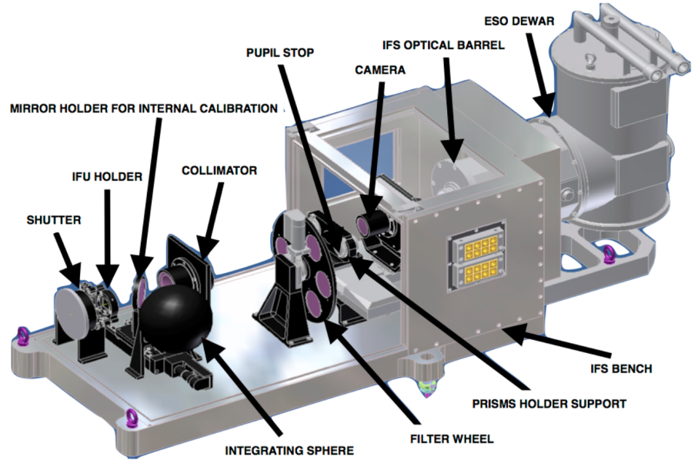
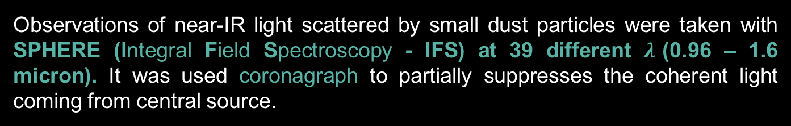
Are All Group I Disks Transitional? Workshop 2017 – 11/10/2017
Prediction: the outer edge of the dust gap should be visible in scattered light for the group I sources, but not for the Group II's. (Maaskant et al. 2013)
Observations of near-IR light scattered by small dust particles were taken with SPHERE (Integral Field Spectroscopy - IFS) at 39 different $λ$(0.96 – 1.6 micron). It was used coronagraph to partially suppresses the coherent light coming from central source.
16 HAeBe stars of our sample
8 HAeBe stars with archival data to have an unbiased sample
Maria Giulia Ubeira Gabellini 8
Notes:
A strong prediction of this scenario is that the outer edge of the dust gap should be visible in scattered light for the Group I sources, but not for the Group II's.
Observations of optical and near-IR light scattered by small dust particles are challenging because of the large contrast in brightness between central star and disk.
SPHERE: new ESO instrument which offer extreme adaptive optics, it has a coronagraph. We are using the IFS data -> integral field spectroscopy
The IFS data are a cube of 39 images at different wavelengths.
For this reason, we applied for SPHERE time to observe 16 nearby Herbig stars. Moreover, we are using also other 8 sources already sampled to study an unbiased sample.
What are the advantages of this method in respect to ADI (rotation of the field of view to correct for speckle noise)?
In our method all wavelengths are taken simultaneusly. ADI is not simultaneus. There are issues in having the same sensitivity of speckles which can change from one obs. to the other one. We have a more stable psf.
B) Our field is not rotating. This method is also applicable to stars which cannot rotate. That’s for every stars.
C) Different self-subtraction. Radial self-subtraction. In ADI you subtract any symmetric pattern.

Slide 12
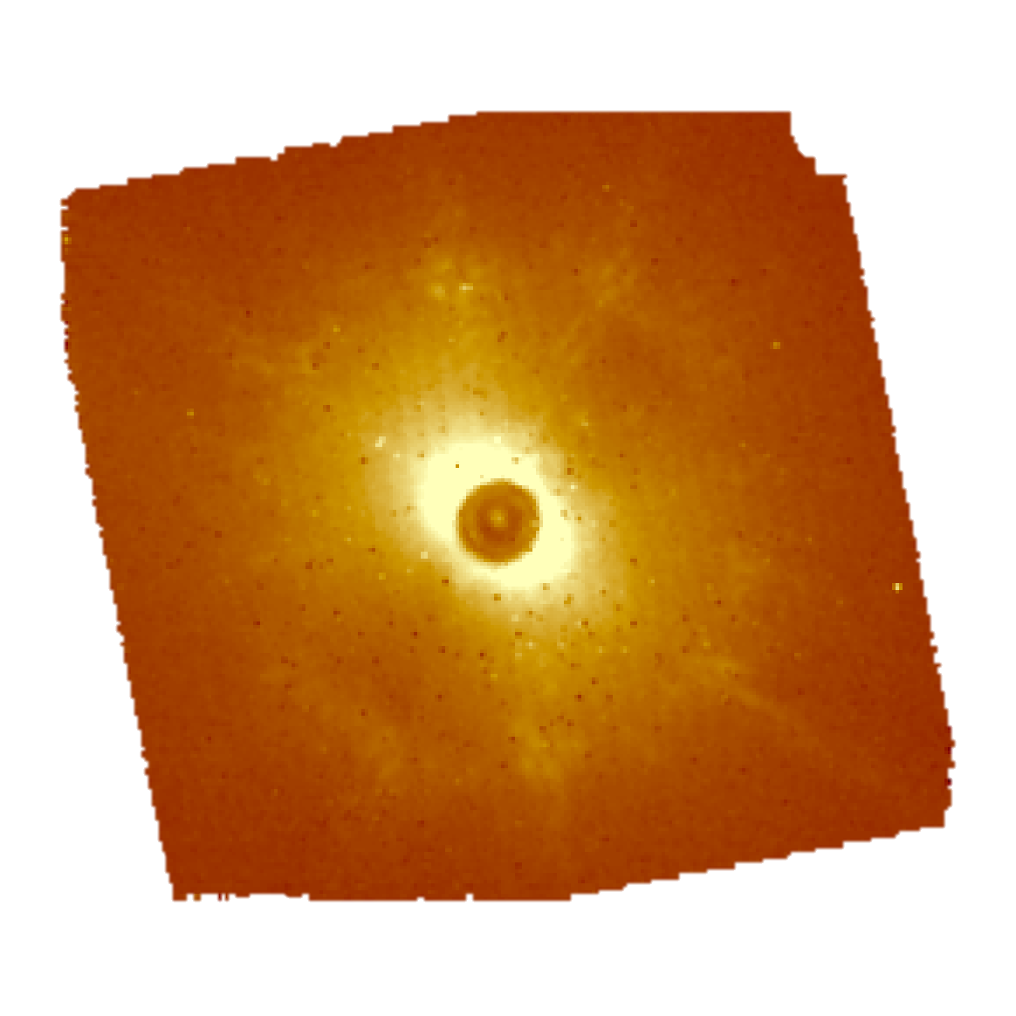
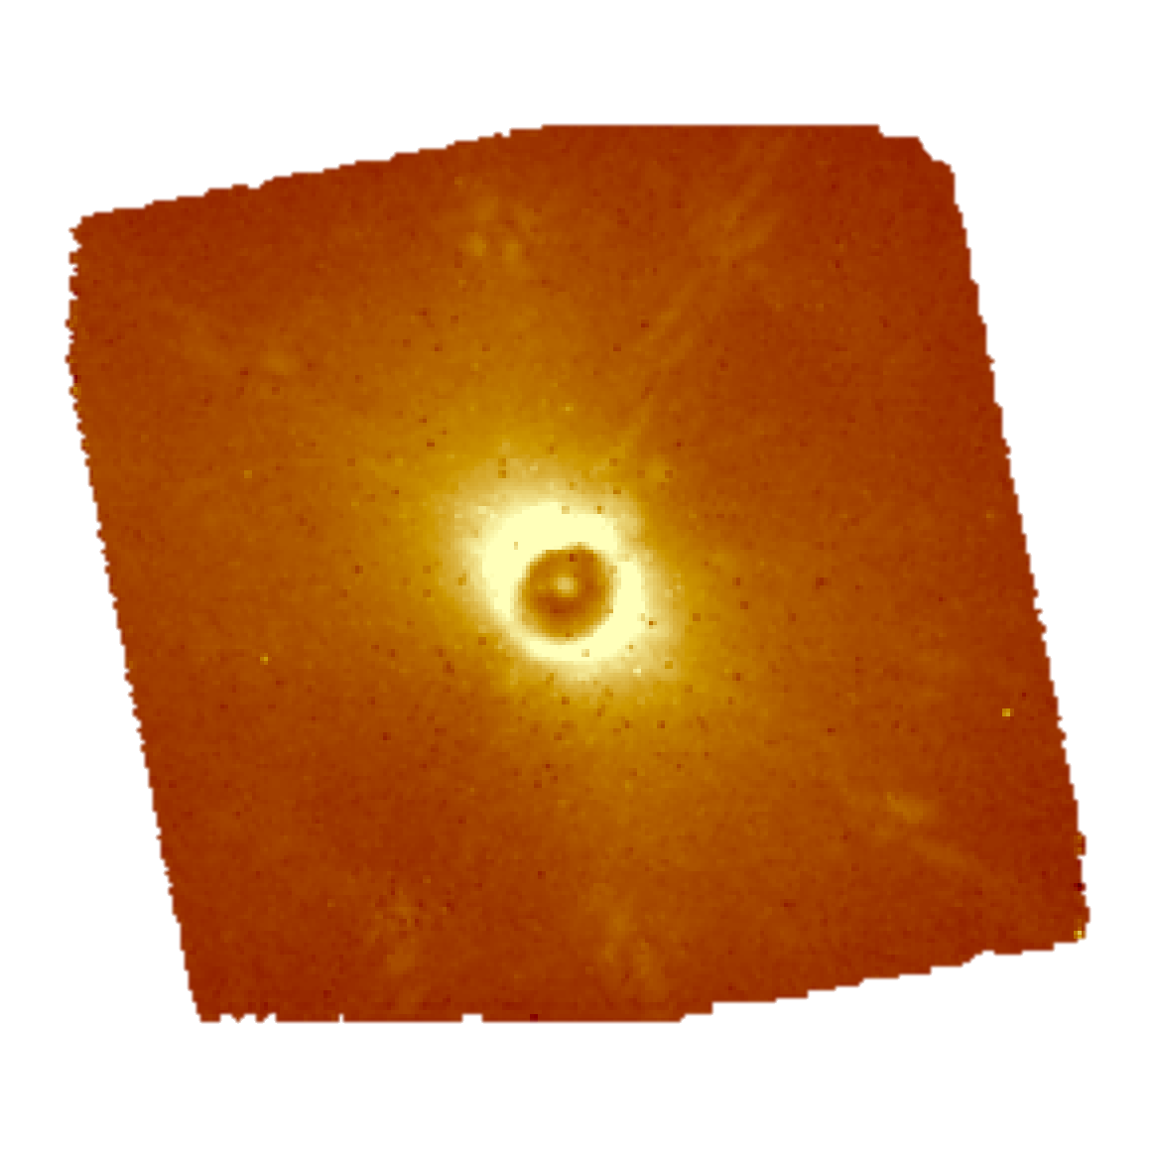
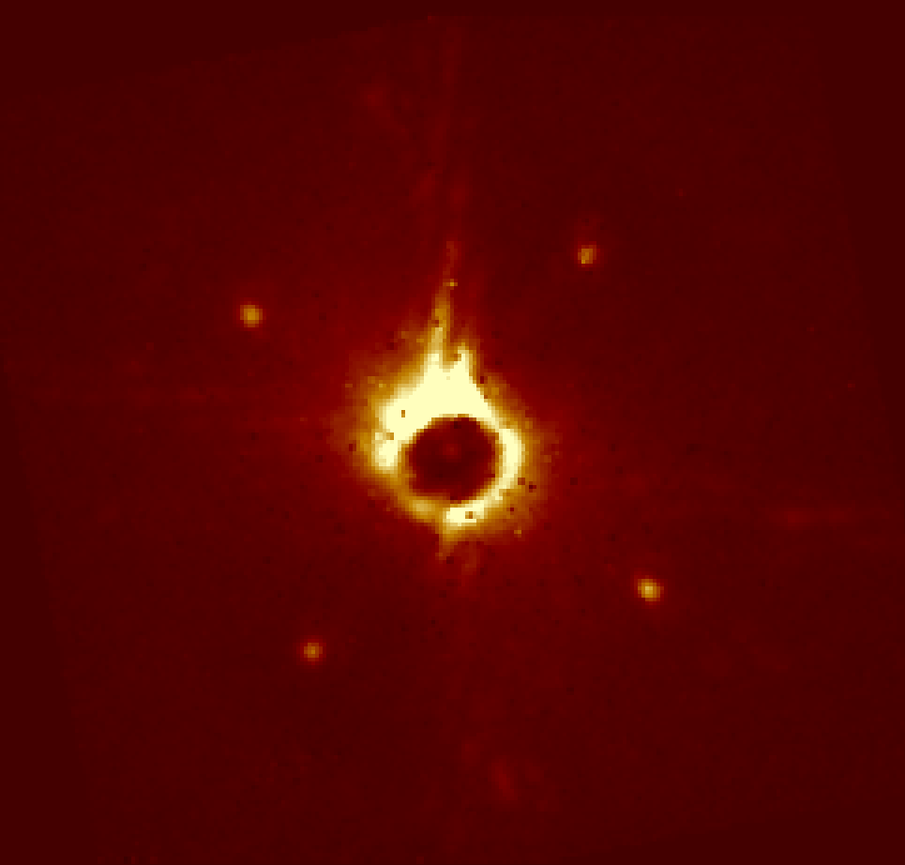
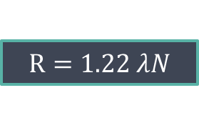
Are All Group I Disks Transitional? Workshop 2017 – 11/10/2017
SPHERE - IFS pipeline on HD 139614:
$$R=1.22 λN$$
Exact position of the star
0.998 micron
1.322 micron
Maria Giulia Ubeira Gabellini 9
Notes:
I will now summarize briefly what I did. First of all I used the ESO - SPHERE pipeline to get these images. Secondly I measured the center of the star using this CENTRE, OBJECT images. Adaptive optics system is creating a waffle pattern on the deformable mirror to produce echoes of the PSF hidden behind the coronagraphic mask at very specific locations. The goal of (Star Center - C) is to accurately measure the position of the star behind the coronagraph. Almost all the feature you can see in these 2 images are artifacts called speckles, which are created by the atmospheric or instrumental wave-front corrugation left uncorrected by the AO system. One of the main goals is to go from the adaptive optics images coming from SPHERE to the high contrast images where the speckles are removed.
We develop a method using this simple criterion. The speckles are moving with the wavelength, whereas the real sources or disk components are not moving. Basically I then used this information to get high contrasted images in 4 different ways. The first method consists …
Here the images we get afterwards.
(7.4 mas)^2 / spaxel.
--------
The second calibration (Star Center - C) applies a waffle pattern on the deformable mirror to produce echoes of the PSF hidden behind the coronagraphic mask at very specific locations. The goal of (Star Center - C) is to accurately measure the position of the star
behind the coronagraph, which is critical for astrometric measurements of off-axis sources.

Slide 13
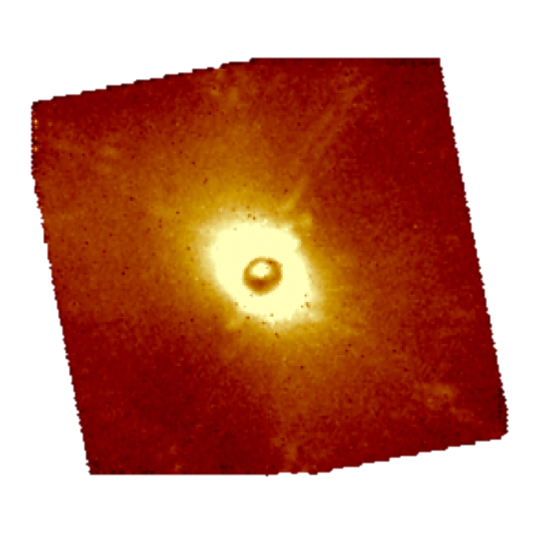
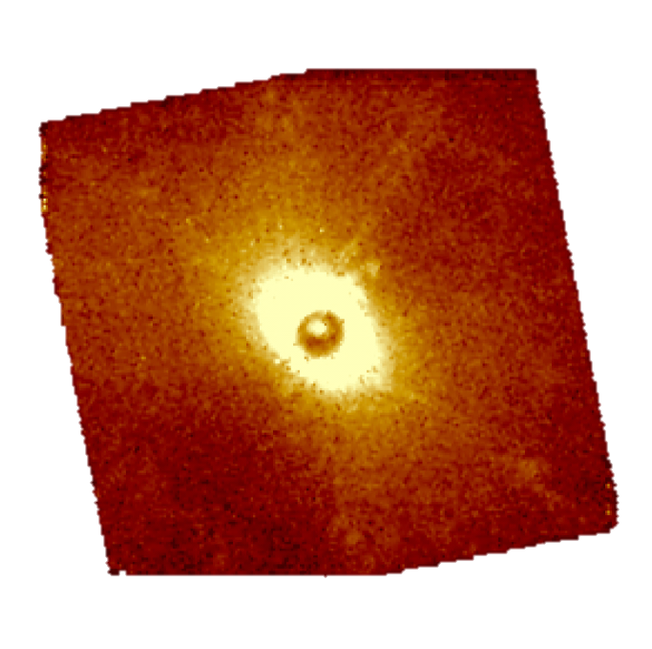
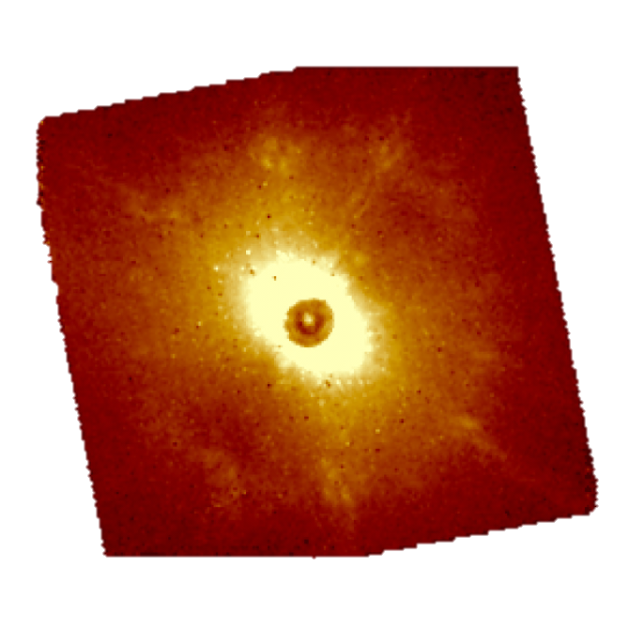
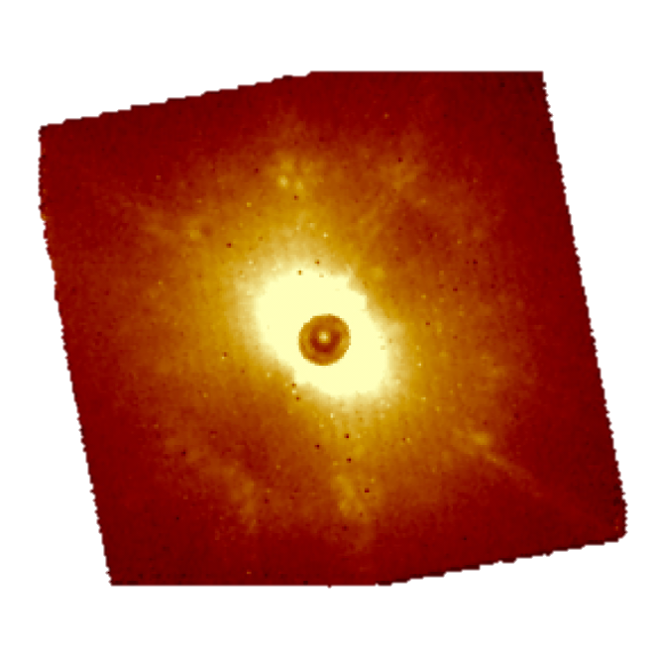
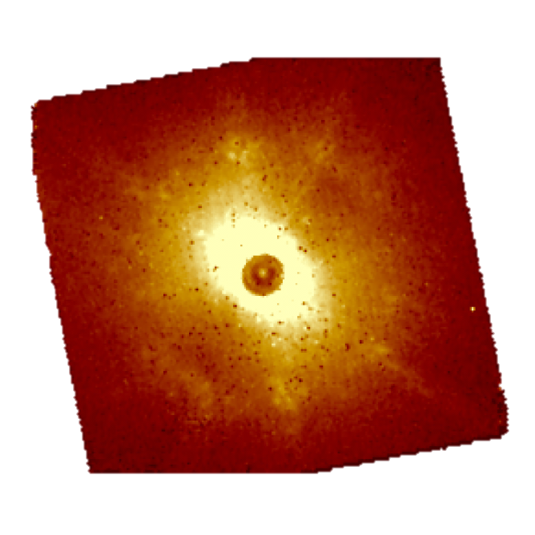
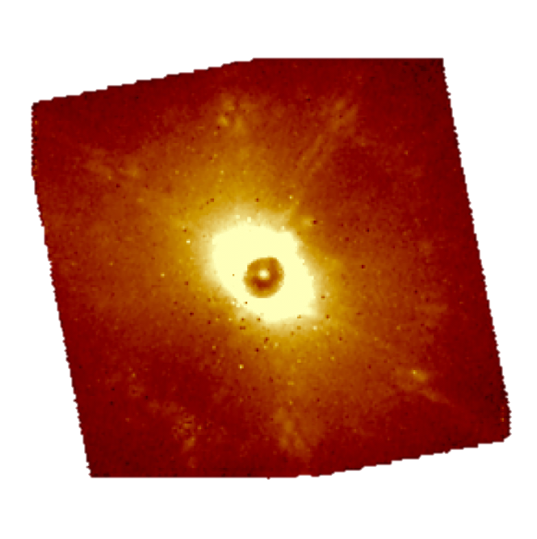
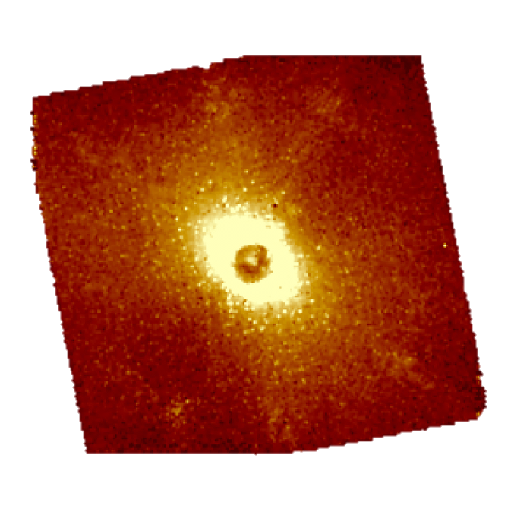
Are All Group I Disks Transitional? Workshop 2017 – 11/10/2017
SPHERE - IFS pipeline on HD 139614:
$$R=1.22 λN$$
Exact position of the star
0.998 micron
1.322 micron
Maria Giulia Ubeira Gabellini 9
Notes:
I will now summarize briefly what I did. First of all I used the ESO - SPHERE pipeline to get these images. Secondly I measured the center of the star using this CENTRE, OBJECT images. Adaptive optics system is creating a waffle pattern on the deformable mirror to produce echoes of the PSF hidden behind the coronagraphic mask at very specific locations. The goal of (Star Center - C) is to accurately measure the position of the star behind the coronagraph. Almost all the feature you can see in these 2 images are artifacts called speckles, which are created by the atmospheric or instrumental wave-front corrugation left uncorrected by the AO system. One of the main goals is to go from the adaptive optics images coming from SPHERE to the high contrast images where the speckles are removed.
We develop a method using this simple criterion. The speckles are moving with the wavelength, whereas the real sources or disk components are not moving. Basically I then used this information to get high contrasted images in 4 different ways. The first method consists …
Here the images we get afterwards.
(7.4 mas)^2 / spaxel.
--------
The second calibration (Star Center - C) applies a waffle pattern on the deformable mirror to produce echoes of the PSF hidden behind the coronagraphic mask at very specific locations. The goal of (Star Center - C) is to accurately measure the position of the star
behind the coronagraph, which is critical for astrometric measurements of off-axis sources.

Slide 14
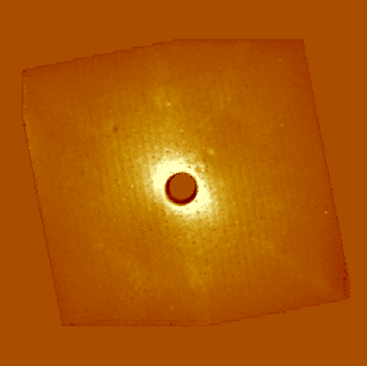
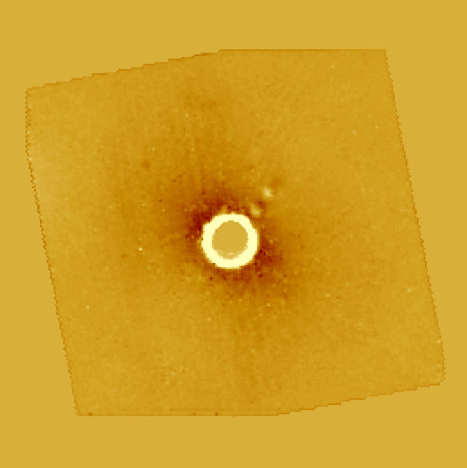
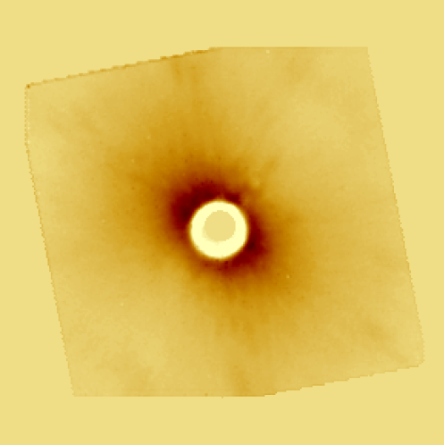
Are All Group I Disks Transitional? Workshop 2017 – 11/10/2017
SPHERE - IFS pipeline on HD 139614:
$$R=1.22 λN$$
Exact position of the star
0.998 micron
1.322 micron
Getting an high contrast image through 4 different methods:
Example: 1st method
Background subtraction
Rescaling of the image
Average weighted map
Scaling back
Subtracted to the original
Y band
J band
H band
Maria Giulia Ubeira Gabellini 9
Notes:
I will now summarize briefly what I did. First of all I used the ESO - SPHERE pipeline to get these images. Secondly I measured the center of the star using this CENTRE, OBJECT images. Adaptive optics system is creating a waffle pattern on the deformable mirror to produce echoes of the PSF hidden behind the coronagraphic mask at very specific locations. The goal of (Star Center - C) is to accurately measure the position of the star behind the coronagraph. Almost all the feature you can see in these 2 images are artifacts called speckles, which are created by the atmospheric or instrumental wave-front corrugation left uncorrected by the AO system. One of the main goals is to go from the adaptive optics images coming from SPHERE to the high contrast images where the speckles are removed.
We develop a method using this simple criterion. The speckles are moving with the wavelength, whereas the real sources or disk components are not moving. Basically I then used this information to get high contrasted images in 4 different ways. The first method consists …
Here the images we get afterwards.
(7.4 mas)^2 / spaxel.
--------
The second calibration (Star Center - C) applies a waffle pattern on the deformable mirror to produce echoes of the PSF hidden behind the coronagraphic mask at very specific locations. The goal of (Star Center - C) is to accurately measure the position of the star
behind the coronagraph, which is critical for astrometric measurements of off-axis sources.

Slide 15
Are All Group I Disks Transitional? Workshop 2017 – 11/10/2017
RESULTS
1) Discs detection
Maria Giulia Ubeira Gabellini 10
Notes:
Coronagraph – we are blind in the inner part
SPIRAL, UNKNOWN COMPANION (FAINT) AND KNOWN ONE M DWARF, dark reflection…
6 stars where there is something resembling a disc.

Slide 16
Are All Group I Disks Transitional? Workshop 2017 – 11/10/2017
RESULTS
2) Companion candidates detection
Maria Giulia Ubeira Gabellini 11
Notes:
4 companion candidates, still spikes.
Follow-up on these sources to test if they can be companions or background stars.

Slide 17
Are All Group I Disks Transitional? Workshop 2017 – 11/10/2017
Properties of the Herbig stars and of the companions:
Maria Giulia Ubeira Gabellini 12
Notes:
First of all it is listed the proper motion of the star - we asked for follow up on these objects in order to test if they are companion or background sources. 1 pix =7.4 mas. I will explain you the METHOD USED TO DERIVE THE MASS: we measured the magnitude at the same lambda for the star and the object, then, knowing the magnitude of the star in that band, we derive the magnitude of the companion candidate. Assuming that they are PHYSICALLY ASSOCIATED (same age and distance, ignoring av) we derived the abs. magnitude and then thanks to the TRACKS of Chabrier and Baraffe we extimate the mass of the source. Here listed the distances between the Herbig stars and their companion candidates.
---------
WE IGNORE AV, which anyway is low because stars are nearby.

Slide 18
Are All Group I Disks Transitional? Workshop 2017 – 11/10/2017
Future work
CQ tau project:
We will run hydrodynamic simulations to address the question if the disk structure could be influenced by the planetary candidate.
We have just got new observations thanks to a accepted follow-up on CQ tau to better resolve the disk structure with ALMA.
Sphere-IFS project:
We propose a follow-up with SPHERE-IFS on the four companion candidates detected.
Testing if the models of Maaskant 2013 are true: all Group I are transitional. Our goal is to see differences in scattered light between this different systems: so far we have found six discs detections.
Are our detection compatible with a simple model prediction?
Maria Giulia Ubeira Gabellini 13
Notes:
To summarize we found so far 4 companion candidates and 6 discs. We asked for follow – up to test if they are companions.
We will test if there all Group I are transitional (different propfiles of scattered light between different possible systems)
We will try to see if we can understand enough from the SED and test if the simple models proposed which give strong predictions about the basic size of the discs are correct.
------
We can say a lot from the SED, but is it enough? Are we really understanding it?
This models are giving strong predictions about the basic size of the discs, this is the most direct way to test it, with some observations.

Slide 19
Are All Group I Disks Transitional? Workshop 2017 – 11/10/2017
Future work
CQ tau project:
We will run hydrodynamic simulations to address the question if the disk structure could be influenced by the planetary candidate.
We have just got new observations thanks to a accepted follow-up on CQ tau to better resolve the disk structure with ALMA.
Sphere-IFS project:
We propose a follow-up with SPHERE-IFS on the four companion candidates detected.
Testing if the models of Maaskant 2013 are true: all Group I are transitional. Our goal is to see differences in scattered light between this different systems: so far we have found six discs detections.
Are our detection compatible with a simple model prediction?
Thank you for your attention!
Maria Giulia Ubeira Gabellini 13
Notes:
To summarize we found so far 4 companion candidates and 6 discs. We asked for follow – up to test if they are companions.
We will test if there all Group I are transitional (different propfiles of scattered light between different possible systems)
We will try to see if we can understand enough from the SED and test if the simple models proposed which give strong predictions about the basic size of the discs are correct.
------
We can say a lot from the SED, but is it enough? Are we really understanding it?
This models are giving strong predictions about the basic size of the discs, this is the most direct way to test it, with some observations.

Slide 20
Are All Group I Disks Transitional? Workshop 2017 – 11/10/2017
Further material
Maria Giulia Ubeira Gabellini 14
Notes:
To summarize we found so far 4 companion candidates and 6 discs. We asked for follow – up to test if they are companions.
We will test if there all Group I are transitional (different propfiles of scattered light between different possible systems)
We will try to see if we can understand enough from the SED and test if the simple models proposed which give strong predictions about the basic size of the discs are correct.
------
We can say a lot from the SED, but is it enough? Are we really understanding it?
This models are giving strong predictions about the basic size of the discs, this is the most direct way to test it, with some observations.

Slide 21
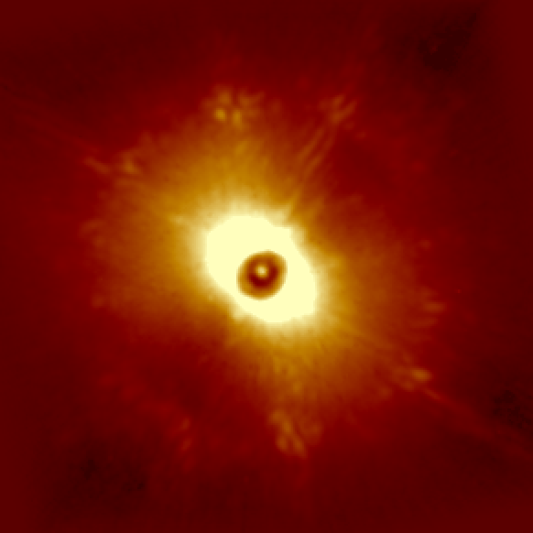
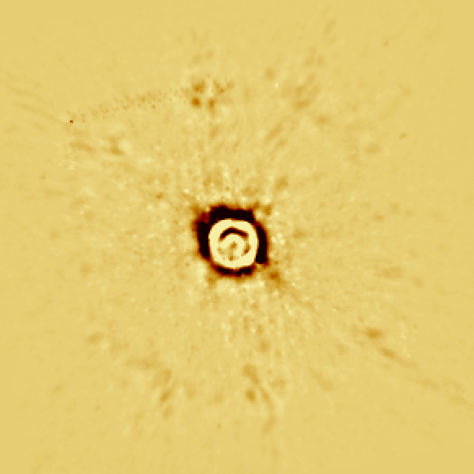
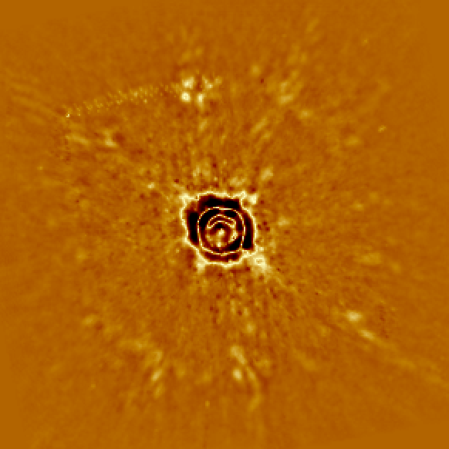
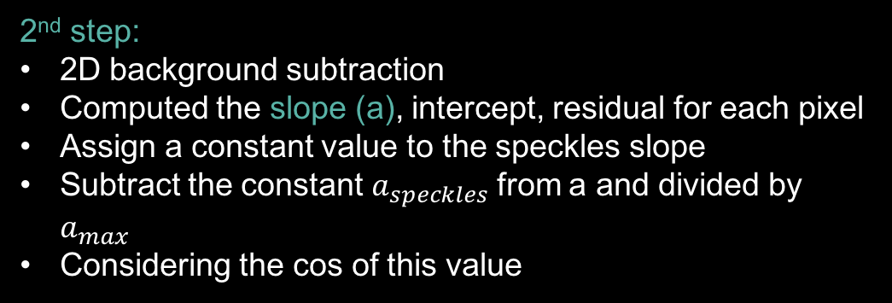

Are All Group I Disks Transitional? Workshop 2017 – 11/10/2017
2nd method
Averaged weighted map
1st step :
Cost background subtraction
Rescaling of the image
Average weighted map
Slope map
2nd step:
2D background subtraction
Computed the slope (a), intercept, residual for each pixel
Assign a constant value to the speckles slope
Subtract the constant $a_{speckles}$ from a and divided by $a_{max}$
Considering the cos of this value
a=-120
a=-61
cos(
- mean($a_{speckles}$))/$a_{max}$ =
Maria Giulia Ubeira Gabellini 10

Slide 22
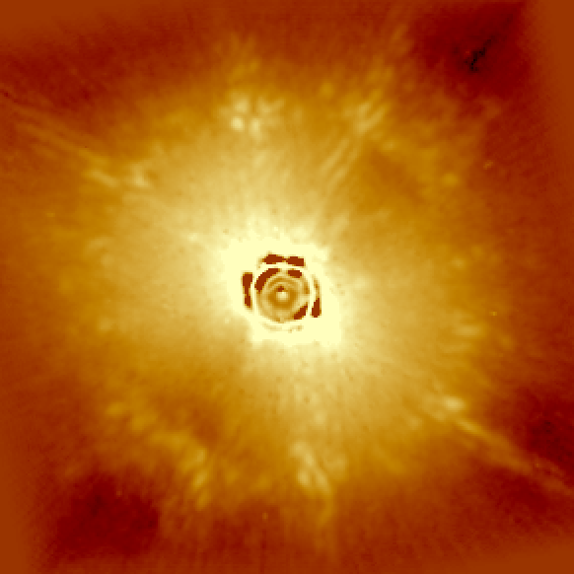




Are All Group I Disks Transitional? Workshop 2017 – 11/10/2017
2nd method
Averaged weighted map
1st step :
…
Average weighted map
Cos flag map
$\sim$1
$$\sim 0.5$$
2nd step:
...
We considered the cos of this value – to have it from -1 to 1: map of speckles
$$\sim 0$$
$$\sim 1$$
3rd step:
Average of 1st step times the map of speckles created with 2nd step
Scaling back
Subtracted to the original image subtracted by the constant background
Maria Giulia Ubeira Gabellini 11

Slide 23
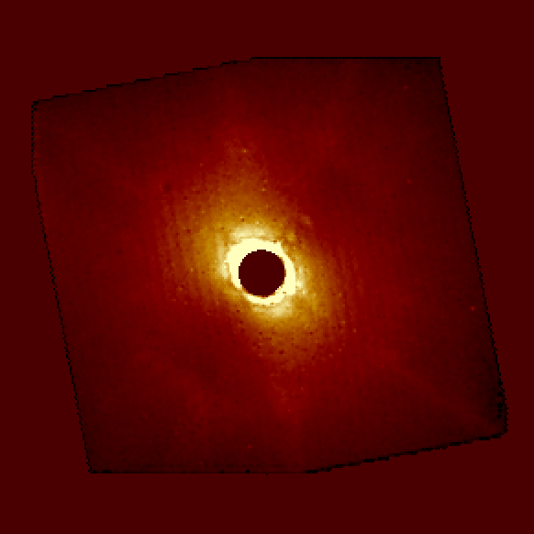
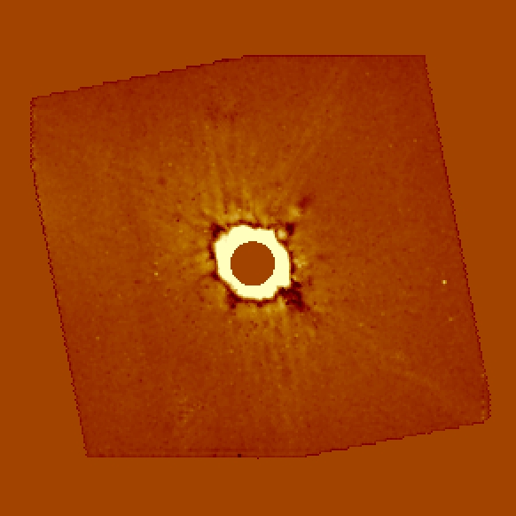
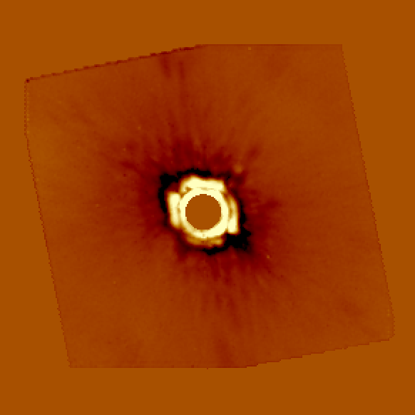
Are All Group I Disks Transitional? Workshop 2017 – 11/10/2017
2nd method
Results:
Y band
J band
H band
Maria Giulia Ubeira Gabellini 12
Notes:
This method in respect to the other one has a worse correction for speckles, but less self-subtraction.
This can be better for studying the extended sources, whereas the first method have to be used for point like sources.
What are the advantages of this method in respect to ADI (rotation of the field of view to correct for speckle noise)?
In our method all wavelengths are taken simultaneusly. ADI is not simultaneus. There are issues in having the same sensitivity of speckles which can change from one obs. to the other one. We have a more stable psf.
B) Our field is not rotating. This method is also applicable to stars which cannot rotate. That’s for every stars.
C) Different self-subtraction. Radial self-subtraction. In ADI you subtract any symmetric pattern.

Slide 24
Are All Group I Disks Transitional? Workshop 2017 – 11/10/2017
SPHERE - IFS pipeline on HD 139614:
$$R=1.22 λN$$
Exact position of the star
0.998 micron
1.322 micron
Maria Giulia Ubeira Gabellini 9
Notes:
I will now summarize briefly what I did. First of all I used the ESO - SPHERE pipeline to get these images. Secondly I measured the center of the star using this CENTRE, OBJECT images. Adaptive optics system is creating a waffle pattern on the deformable mirror to produce echoes of the PSF hidden behind the coronagraphic mask at very specific locations. The goal of (Star Center - C) is to accurately measure the position of the star behind the coronagraph. Almost all the feature you can see in these 2 images are artifacts called speckles, which are created by the atmospheric or instrumental wave-front corrugation left uncorrected by the AO system. One of the main goals is to go from the adaptive optics images coming from SPHERE to the high contrast images where the speckles are removed.
We develop a method using this simple criterion. The speckles are moving with the wavelength, whereas the real sources or disk components are not moving. Basically I then used this information to get high contrasted images in 4 different ways. The first method consists …
Here the images we get afterwards.
(7.4 mas)^2 / spaxel.
--------
The second calibration (Star Center - C) applies a waffle pattern on the deformable mirror to produce echoes of the PSF hidden behind the coronagraphic mask at very specific locations. The goal of (Star Center - C) is to accurately measure the position of the star
behind the coronagraph, which is critical for astrometric measurements of off-axis sources.

Slide 25
Are All Group I Disks Transitional? Workshop 2017 – 11/10/2017
SPHERE - IFS pipeline on HD 139614:
$$R=1.22 λN$$
Exact position of the star
0.998 micron
1.322 micron
Maria Giulia Ubeira Gabellini 9
Notes:
I will now summarize briefly what I did. First of all I used the ESO - SPHERE pipeline to get these images. Secondly I measured the center of the star using this CENTRE, OBJECT images. Adaptive optics system is creating a waffle pattern on the deformable mirror to produce echoes of the PSF hidden behind the coronagraphic mask at very specific locations. The goal of (Star Center - C) is to accurately measure the position of the star behind the coronagraph. Almost all the feature you can see in these 2 images are artifacts called speckles, which are created by the atmospheric or instrumental wave-front corrugation left uncorrected by the AO system. One of the main goals is to go from the adaptive optics images coming from SPHERE to the high contrast images where the speckles are removed.
We develop a method using this simple criterion. The speckles are moving with the wavelength, whereas the real sources or disk components are not moving. Basically I then used this information to get high contrasted images in 4 different ways. The first method consists …
Here the images we get afterwards.
(7.4 mas)^2 / spaxel.
--------
The second calibration (Star Center - C) applies a waffle pattern on the deformable mirror to produce echoes of the PSF hidden behind the coronagraphic mask at very specific locations. The goal of (Star Center - C) is to accurately measure the position of the star
behind the coronagraph, which is critical for astrometric measurements of off-axis sources.

Slide 26
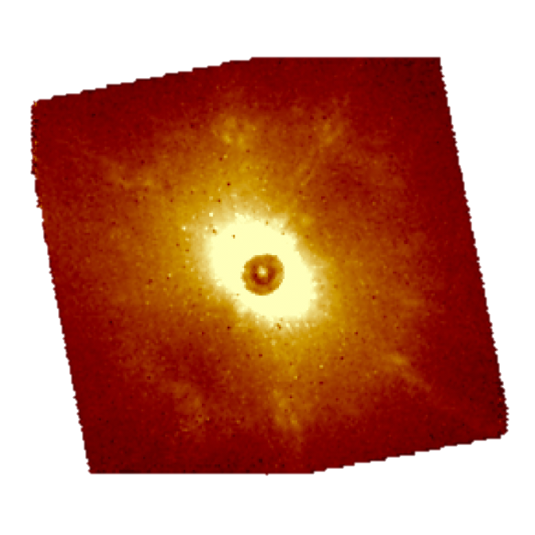
Are All Group I Disks Transitional? Workshop 2017 – 11/10/2017
SPHERE - IFS pipeline on HD 139614:
$$R=1.22 λN$$
Exact position of the star
0.998 micron
1.322 micron
Maria Giulia Ubeira Gabellini 9
Notes:
I will now summarize briefly what I did. First of all I used the ESO - SPHERE pipeline to get these images. Secondly I measured the center of the star using this CENTRE, OBJECT images. Adaptive optics system is creating a waffle pattern on the deformable mirror to produce echoes of the PSF hidden behind the coronagraphic mask at very specific locations. The goal of (Star Center - C) is to accurately measure the position of the star behind the coronagraph. Almost all the feature you can see in these 2 images are artifacts called speckles, which are created by the atmospheric or instrumental wave-front corrugation left uncorrected by the AO system. One of the main goals is to go from the adaptive optics images coming from SPHERE to the high contrast images where the speckles are removed.
We develop a method using this simple criterion. The speckles are moving with the wavelength, whereas the real sources or disk components are not moving. Basically I then used this information to get high contrasted images in 4 different ways. The first method consists …
Here the images we get afterwards.
(7.4 mas)^2 / spaxel.
--------
The second calibration (Star Center - C) applies a waffle pattern on the deformable mirror to produce echoes of the PSF hidden behind the coronagraphic mask at very specific locations. The goal of (Star Center - C) is to accurately measure the position of the star
behind the coronagraph, which is critical for astrometric measurements of off-axis sources.

Slide 27
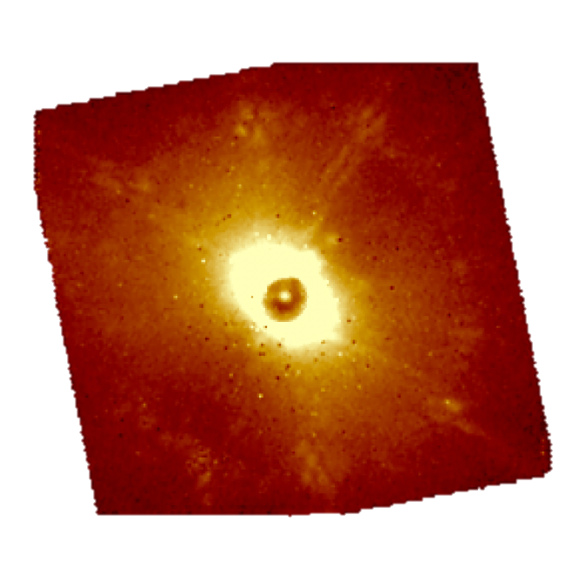
Are All Group I Disks Transitional? Workshop 2017 – 11/10/2017
SPHERE - IFS pipeline on HD 139614:
$$R=1.22 λN$$
Exact position of the star
0.998 micron
1.322 micron
Maria Giulia Ubeira Gabellini 9
Notes:
I will now summarize briefly what I did. First of all I used the ESO - SPHERE pipeline to get these images. Secondly I measured the center of the star using this CENTRE, OBJECT images. Adaptive optics system is creating a waffle pattern on the deformable mirror to produce echoes of the PSF hidden behind the coronagraphic mask at very specific locations. The goal of (Star Center - C) is to accurately measure the position of the star behind the coronagraph. Almost all the feature you can see in these 2 images are artifacts called speckles, which are created by the atmospheric or instrumental wave-front corrugation left uncorrected by the AO system. One of the main goals is to go from the adaptive optics images coming from SPHERE to the high contrast images where the speckles are removed.
We develop a method using this simple criterion. The speckles are moving with the wavelength, whereas the real sources or disk components are not moving. Basically I then used this information to get high contrasted images in 4 different ways. The first method consists …
Here the images we get afterwards.
(7.4 mas)^2 / spaxel.
--------
The second calibration (Star Center - C) applies a waffle pattern on the deformable mirror to produce echoes of the PSF hidden behind the coronagraphic mask at very specific locations. The goal of (Star Center - C) is to accurately measure the position of the star
behind the coronagraph, which is critical for astrometric measurements of off-axis sources.

Slide 28

Are All Group I Disks Transitional? Workshop 2017 – 11/10/2017
SPHERE - IFS pipeline on HD 139614:
$$R=1.22 λN$$
Exact position of the star
0.998 micron
1.322 micron
Maria Giulia Ubeira Gabellini 9
Notes:
I will now summarize briefly what I did. First of all I used the ESO - SPHERE pipeline to get these images. Secondly I measured the center of the star using this CENTRE, OBJECT images. Adaptive optics system is creating a waffle pattern on the deformable mirror to produce echoes of the PSF hidden behind the coronagraphic mask at very specific locations. The goal of (Star Center - C) is to accurately measure the position of the star behind the coronagraph. Almost all the feature you can see in these 2 images are artifacts called speckles, which are created by the atmospheric or instrumental wave-front corrugation left uncorrected by the AO system. One of the main goals is to go from the adaptive optics images coming from SPHERE to the high contrast images where the speckles are removed.
We develop a method using this simple criterion. The speckles are moving with the wavelength, whereas the real sources or disk components are not moving. Basically I then used this information to get high contrasted images in 4 different ways. The first method consists …
Here the images we get afterwards.
(7.4 mas)^2 / spaxel.
--------
The second calibration (Star Center - C) applies a waffle pattern on the deformable mirror to produce echoes of the PSF hidden behind the coronagraphic mask at very specific locations. The goal of (Star Center - C) is to accurately measure the position of the star
behind the coronagraph, which is critical for astrometric measurements of off-axis sources.

Slide 29

Are All Group I Disks Transitional? Workshop 2017 – 11/10/2017
SPHERE - IFS pipeline on HD 139614:
$$R=1.22 λN$$
Exact position of the star
0.998 micron
1.322 micron
Maria Giulia Ubeira Gabellini 9
Notes:
I will now summarize briefly what I did. First of all I used the ESO - SPHERE pipeline to get these images. Secondly I measured the center of the star using this CENTRE, OBJECT images. Adaptive optics system is creating a waffle pattern on the deformable mirror to produce echoes of the PSF hidden behind the coronagraphic mask at very specific locations. The goal of (Star Center - C) is to accurately measure the position of the star behind the coronagraph. Almost all the feature you can see in these 2 images are artifacts called speckles, which are created by the atmospheric or instrumental wave-front corrugation left uncorrected by the AO system. One of the main goals is to go from the adaptive optics images coming from SPHERE to the high contrast images where the speckles are removed.
We develop a method using this simple criterion. The speckles are moving with the wavelength, whereas the real sources or disk components are not moving. Basically I then used this information to get high contrasted images in 4 different ways. The first method consists …
Here the images we get afterwards.
(7.4 mas)^2 / spaxel.
--------
The second calibration (Star Center - C) applies a waffle pattern on the deformable mirror to produce echoes of the PSF hidden behind the coronagraphic mask at very specific locations. The goal of (Star Center - C) is to accurately measure the position of the star
behind the coronagraph, which is critical for astrometric measurements of off-axis sources.

Slide 30
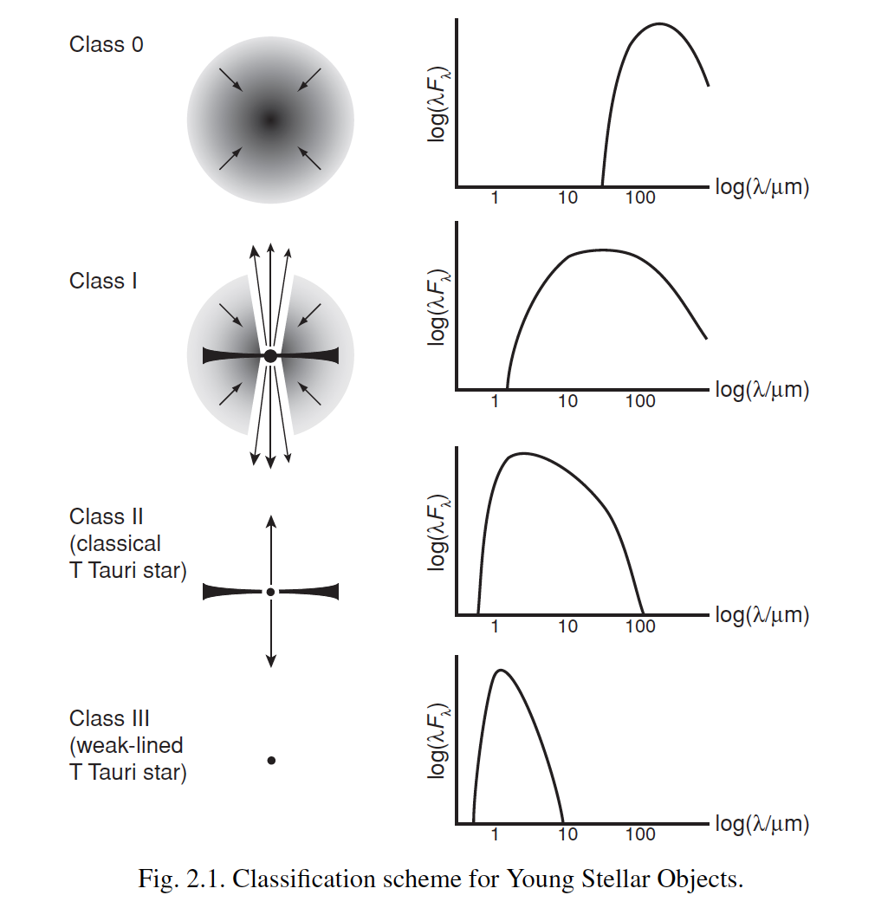
Are All Group I Disks Transitional? Workshop 2017 – 11/10/2017
Maria Giulia Ubeira Gabellini 12

