Slide 1
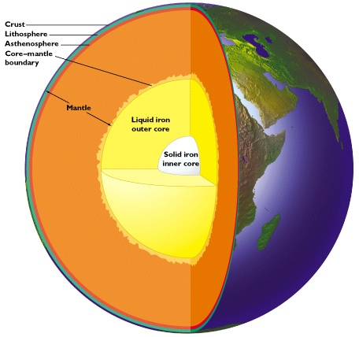
Geoneutrinos and heat production in the Earth
Bill McDonough, *Scott Wipperfurth *Yu Huang and ⁺Ondřej Šrámek
Geology, U Maryland
Fabio Mantovani and *Virginia Strati,
Physics, U Ferrara and INFN, Italy
Steve Dye, Natural Science,
Hawaii Pacific U and Physics, U Hawaii
John Learned, Physics, U Hawaii
*graduate student
⁺post-doc
Notes:
The kTon-scale, underground, liquid scintillation detectors at KamLAND and Borexino, which measure the flux of electron antineutrino from the Earth (i.e., geoneutrino) and nuclear reactors, reveal that radiogenic heat from the decay of Th and U (only detectable signal) contributes between 20% and 50% of the Earth’s present-day power (46±3 TW). This year the SNO+ (Canada) detector comes on line and later this decade China's JUNO experiment, which is 20 times larger than the largest existing detectors, will likely begin counting. These particle physics experiments
are now establishing limits on acceptable compositional models for the Earth and defining the amount of nuclear power inside the Earth available to drive plate tectonics, mantle convection, and the geodynamo.

Slide 2
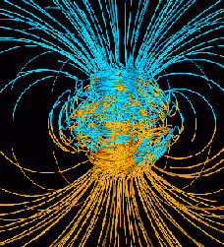
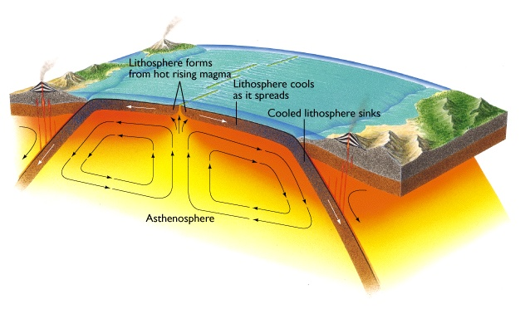
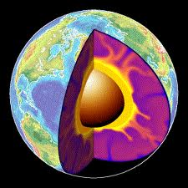
Plate Tectonics,
Convection,
Geodynamo
Radioactive decay driving the Earth’s engine!
K, Th & U!

Slide 3
Nature & amount of Earth’s thermal power
radiogenic heating vs secular cooling
- abundance of heat producing elements (K, Th, U) in the Earth
- clues to planet formation processes
- amount of radiogenic power to drive mantle convection & plate tectonics
- is the mantle compositionally layered? or has large structures?
estimates of BSE from 9TW to 36TW
constrains chondritic Earth models
estimates of mantle 1.3TW to 28TW
layers, LLSVP, superplume piles
the future is… Geoneutrino studies

Slide 4
Disagreement with “chondritic” Earth Models
Murakami et al (May - 2012, Nature): “…the lower mantle is enriched in silicon … consistent with the [CI] chondritic Earth model.”
Campbell and O’Neill (March - 2012, Nature): “Evidence against a chondritic Earth”
Zhang et al (March - 2012, Nature Geoscience): The Ti isotopic composition of the Earth and Moon overlaps that of enstatite chondrites.
Fitoussi and Bourdon (March - 2012, Science): “Si isotopes support the conclusion that Earth was not built solely from enstatite chondrites.”
Warren (Nov - 2011, EPSL): “Among known chondrite groups, EH yields a relatively close fit to the stable-isotopic composition of Earth.”
- Compositional models differ widely, implying a factor of three difference in the U & Th abundances of the Earth

Slide 5
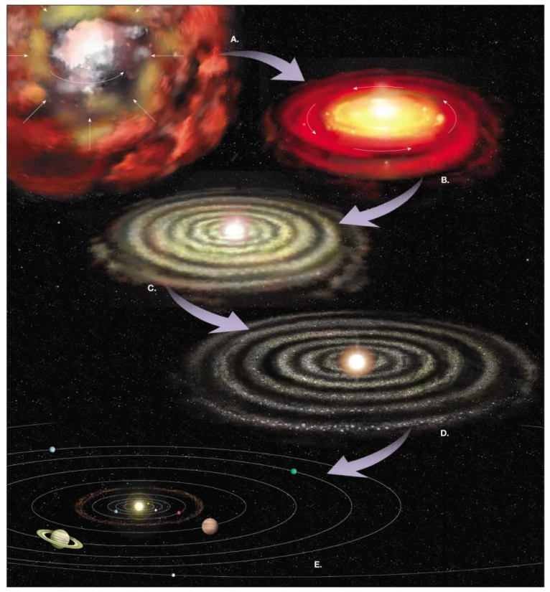
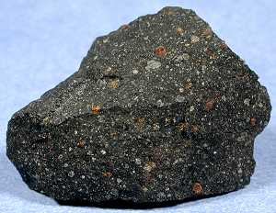
What is the composition of the Earth?
and where did this stuff come from?
Nebula
Meteorite
Heterogeneous mixtures of components with different formation temperatures and conditions
Planet:
mix of metal, silicate, volatiles

Slide 6
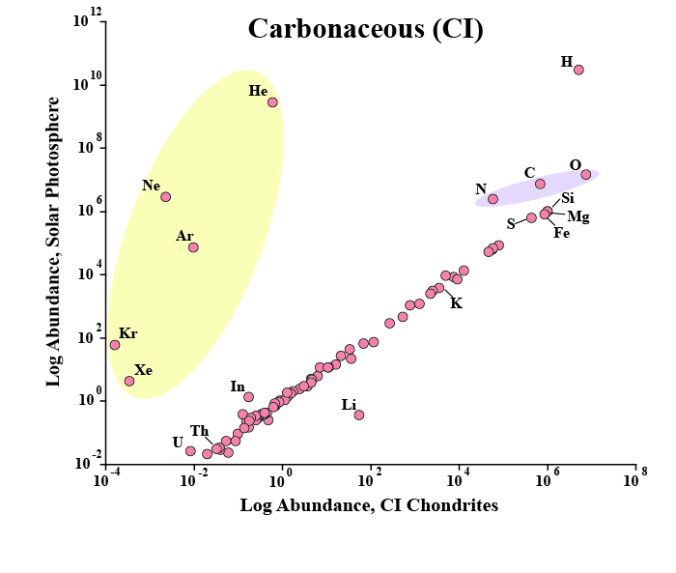
Sun and Chondrites are related
K, Th & U
heat producing elements

Slide 7
Most studied meteorites
fell to the Earth ≤0.1 Ma ago

Slide 8
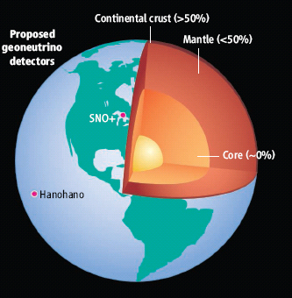
~13 ng/g U in the Earth
Metallic sphere (core)
<<<1 ng/g U
Silicate sphere
20* ng/g U
*O’Neill & Palme (2008) 10 ng/g
*Turcotte & Schubert (2002) 31 ng/g
Continental Crust
1300 ng/g U (~7 TW)
Mantle
~13* ng/g U (~13 TW)
U in the Earth:
[Th/U = 3.9, K//U = 1.3 x 10⁴]
*Mantle could have as little
1-3 TW or as much as 28 TW

Slide 9
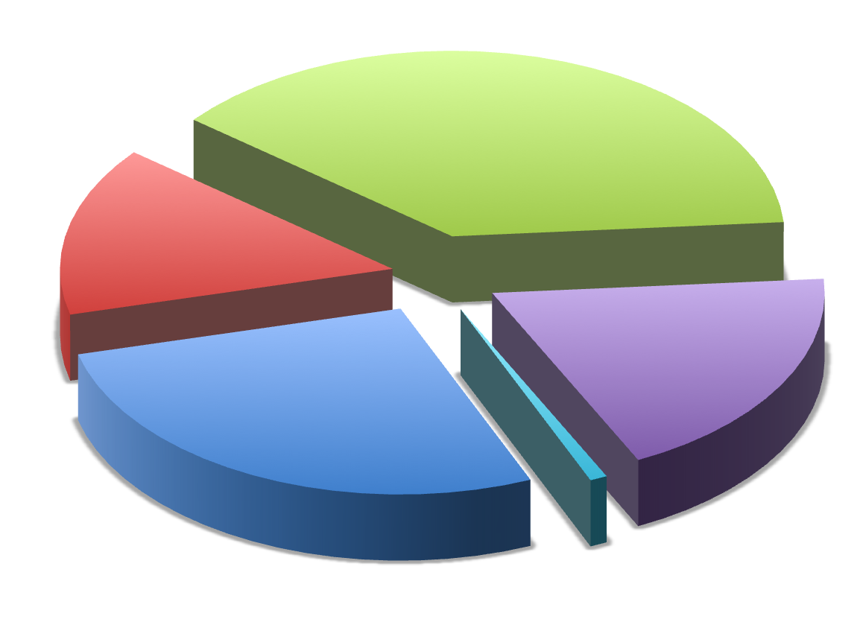
Earth’s surface heat flow 46 ± 3 (47 ± 1) TW
Mantle cooling
(18 TW)
Crust R*
(7 ± 1 TW)
(Huang et al ‘13)
Core
(~9 TW)
-
(4-15 TW)
Mantle R*
(13 ± 4 TW)
total R*
20 ± 4
*R radiogenic heat
(after McDonough & Sun ’95)
(0.4 TW) Tidal dissipation
Chemical differentiation
after Jaupart et al 2008 Treatise of Geophysics

Slide 10
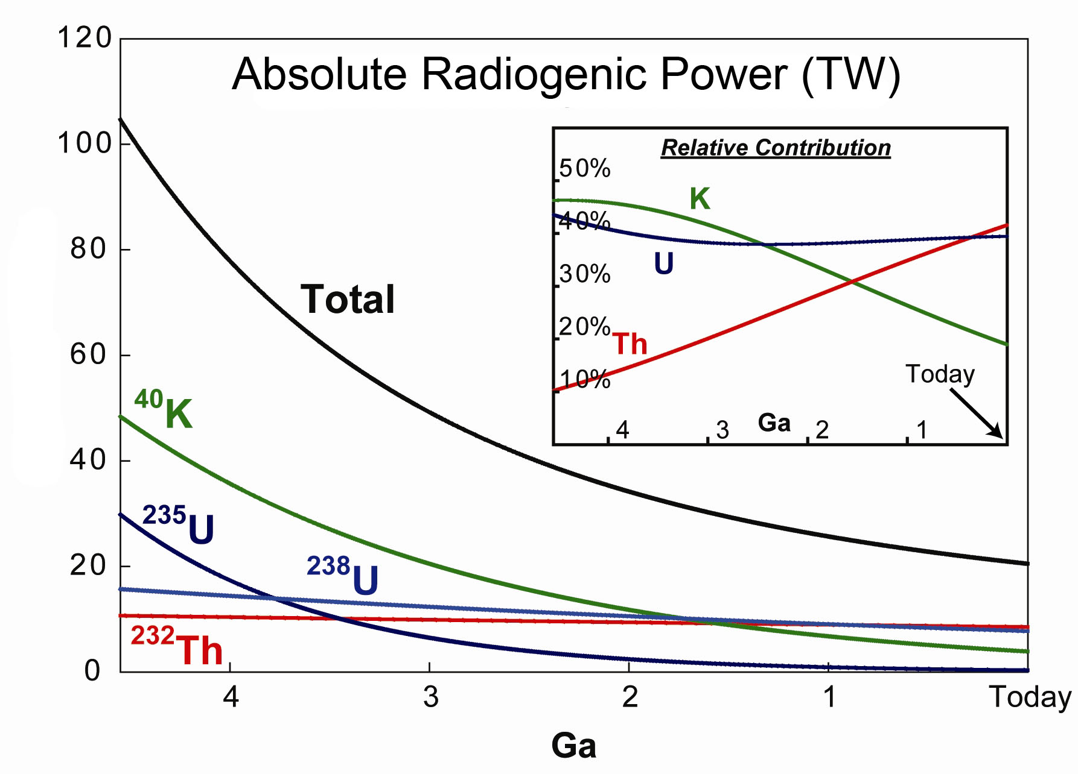
Earth’s thermal evolution: role of K, Th & U
Archean boundary
Power (TW)
Arevalo, McDonough, Luong (2009) EPSL doi:10.1016/j.epsl.2008.12.023

Slide 11
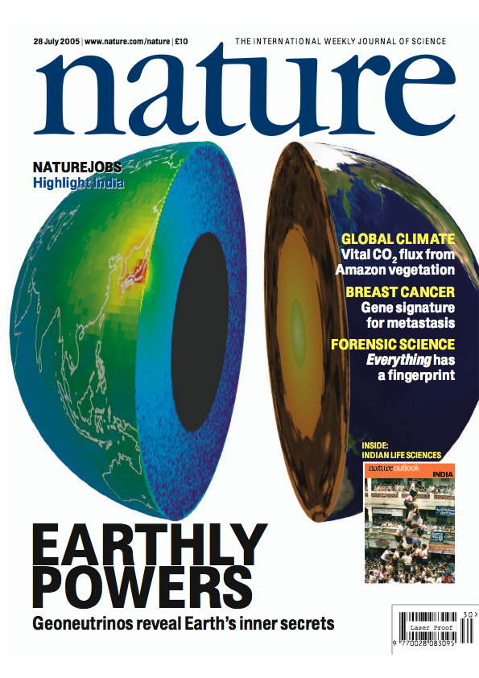
2011
Detecting
Geoneutrinos
from the Earth
Latest Borexino results in Bellini et al 2013
Physics Letters B 722, 295–300
2005
Latest KamLAND results in Gando et al 2013
Physical Review D 88, 033001
2010

Slide 12
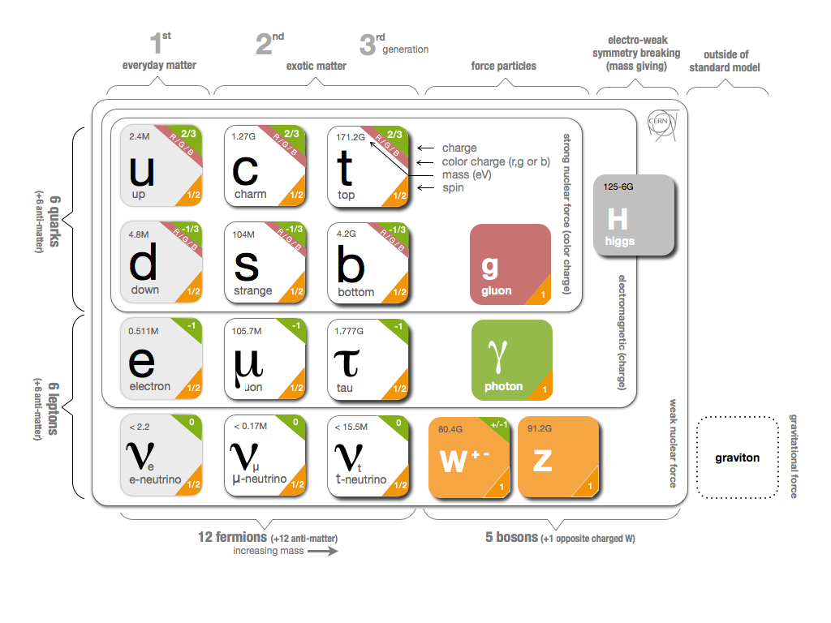
What are Geoneutrinos?
electron anti-neutrinos from the Earth, products of natural radioactivity
Geoneutrino flux
- typical flux 6*10⁶ cm⁻² s⁻¹
Force
carriers
Quarks
Leptons
Anti-neutrino
-vs- neutrino

Slide 13
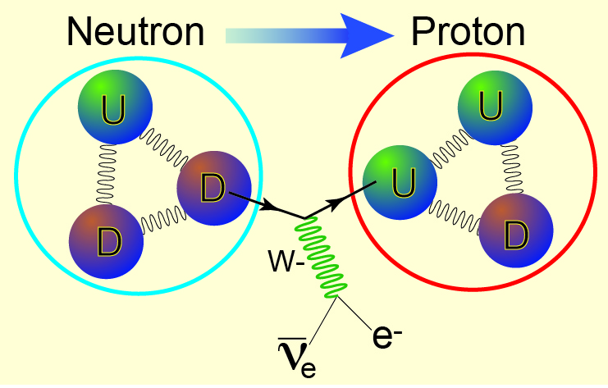
β ⁻ decay process (e.g., U, Th, K, Re, Lu, Rb)
up
quark
down
quark
electron
anti-neutrino

Slide 14
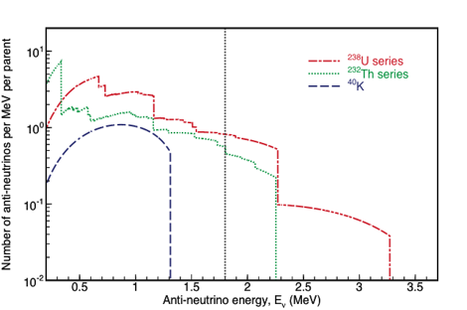
Terrestrial Antineutrinos
²³⁸U
²³²Th
ν_{e} + p⁺ → n + e⁺
1.8 MeV Energy Threshold
1α, 1β
1α, 1β
ν_{e}
²³⁸U
²³²Th
⁴⁰K
ν_{e}
²³⁴Pa
²²⁸Ac
2.3 MeV
2.1 MeV
31%
1%
5α, 2β
4α, 2β
ν_{e}
ν_{e}
²¹⁴Bi
²¹²Bi
3.3 MeV
2.3 MeV
48%
20%
⁴⁰K
⁴⁰Ca
Efforts to detect
K geonus
underway
2α, 3β
1β
1α, 1β
²⁰⁶Pb
Terrestrial antineutrinos from
uranium and thorium are detectable
²⁰⁸Pb

Slide 15
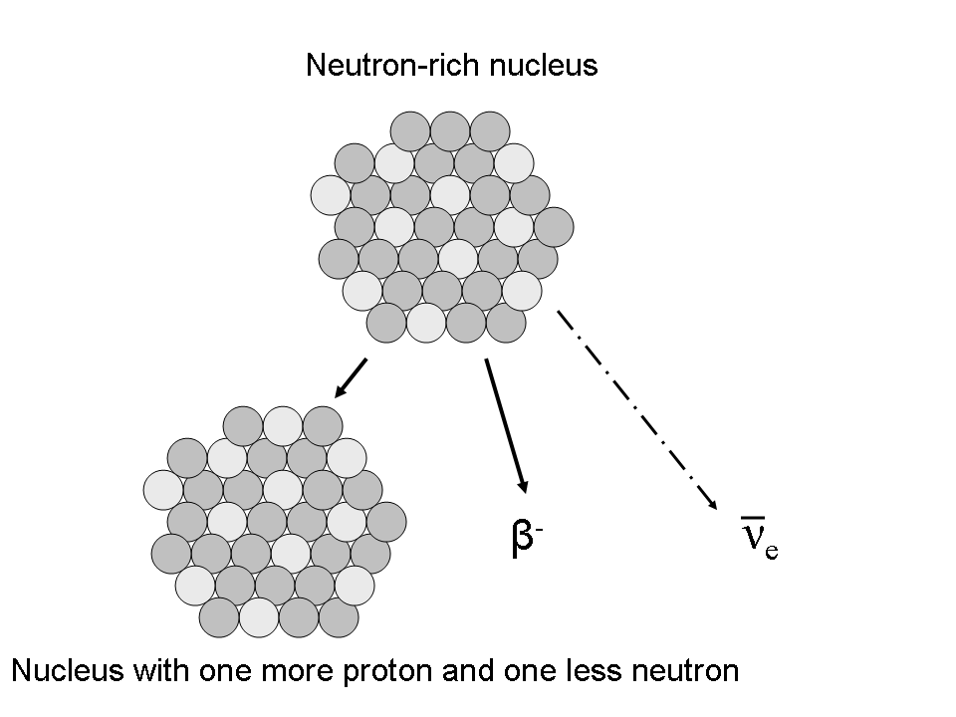
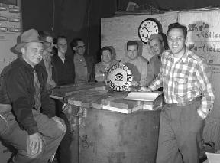
MeV-Scale Electron Anti-Neutrino Detection
Key: 2 flashes, close in space and time,
2nd of known energy, eliminate background
Production in reactors
and natural decays
Detection
E_{vis}=E_{ν}-0.8 MeV
prompt
delayed
E_{vis}=2.2 MeV
Standard inverse β-decay coincidence
E_{ν} > 1.8 MeV
Rate and spectrum - no direction
Reines & Cowan

Slide 17
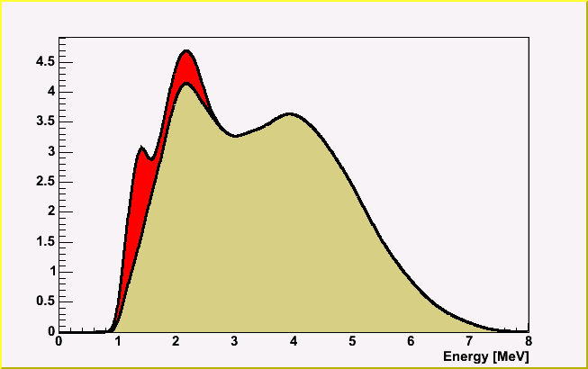
Reactor and Earth Signal
Geoneutrinos
KamLAND
Reactor Background
with oscillation
KamLAND was designed to measure reactor antineutrinos.
Reactor antineutrinos are the most significant contributor to the total signal.
Notes:
KamLAND was designed to detect reactor antineutrinos to measure the neutrino oscillation parameters. The picture shows the locations of KamLAND and all the nearby nuclear reactors. Nuclear reactors are indicated by the red-green dots. Naturally, the most significant background for geoneutrino detection is the antineutrinos from these reactors. The right plot shows the expected energy distributions of the geoneutrino spectrum and reactor background.

Slide 18
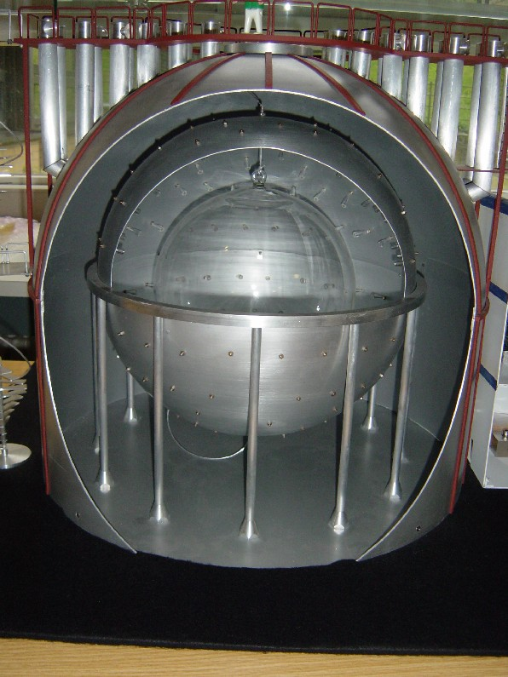
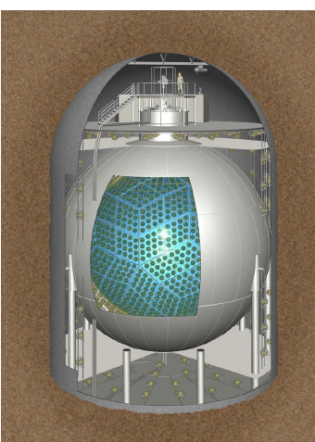
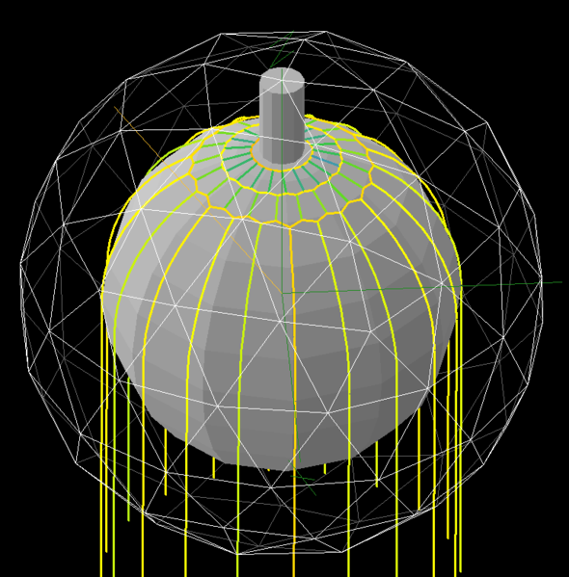
Present LS-detectors, data update
Borexino, Italy (0.3kt)
SNO+, Canada (1kt)
KamLAND, Japan (1kt)
under construction
(online later this yr?)
14±4 counts
116
+28
-27
counts
from May ‘07 to Nov ‘12
From 9 Mar ‘02 to 20 Nov ‘12

Slide 19
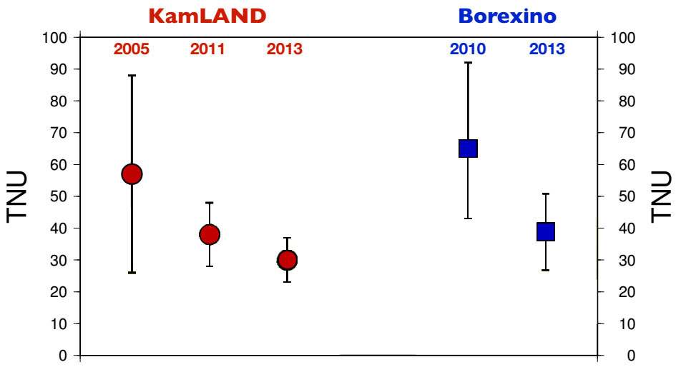
Can Physics Help Geoscience?
TNU: geo-nυ event seen by a kiloton detector in a year

Slide 20
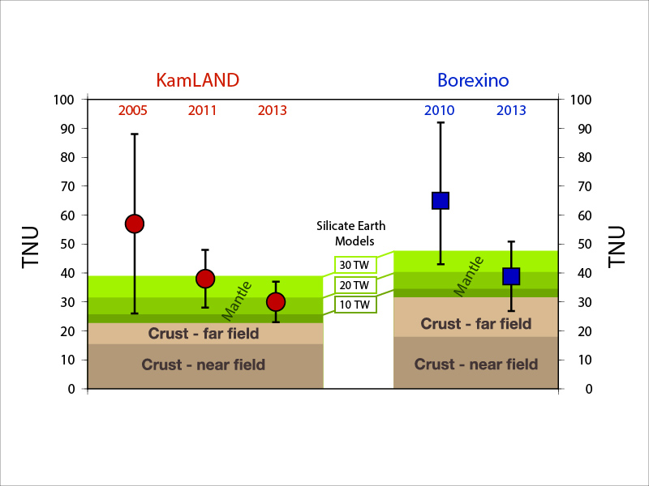
Summary of geoneutrino results
Silicate Earth MODELS
Cosmochemical: uses meteorites – 10 TW
Geochemical: uses terrestrial rocks –20 TW
Geodynamical: parameterized convection – 30 TW

Slide 21
Geoneutrino Flux on Earth Surface
Activity and number of produced geoneutrinos
Volume of source unit
Survival probability function
Abundance and density of the source unit
Distance between source unit and detector
Earth structure (ρ and L) and chemical composition (a)

Slide 22
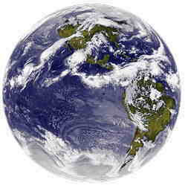
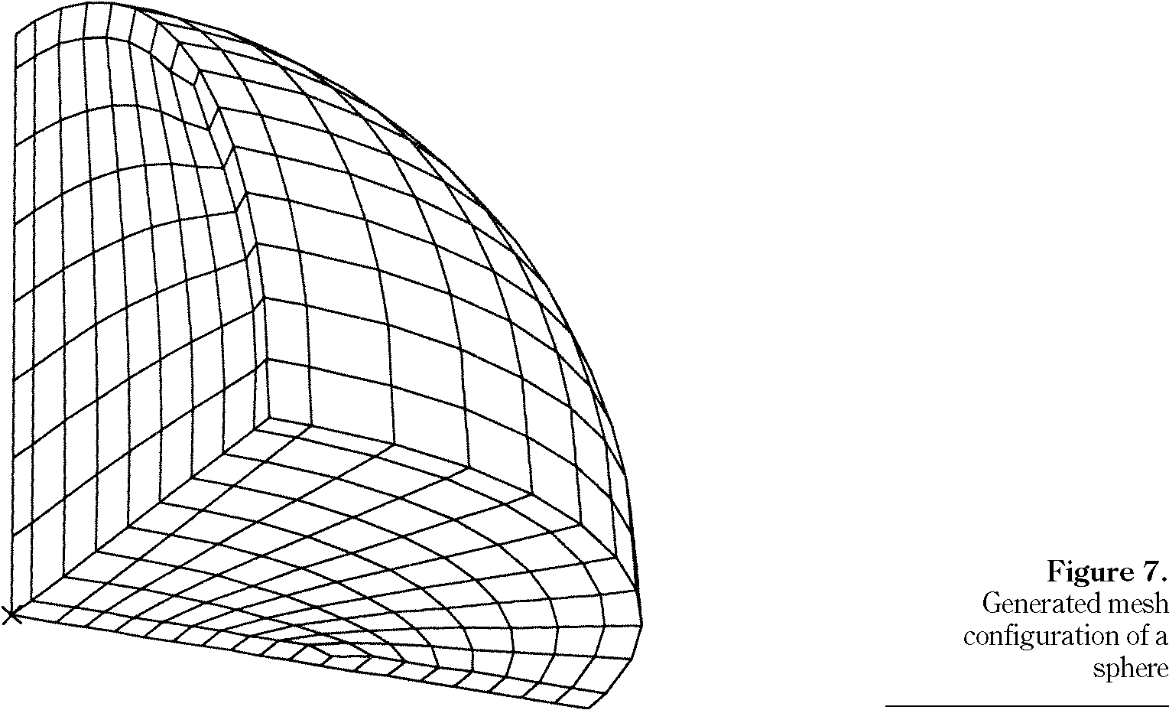
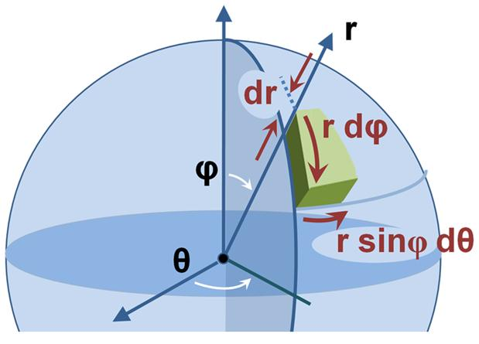
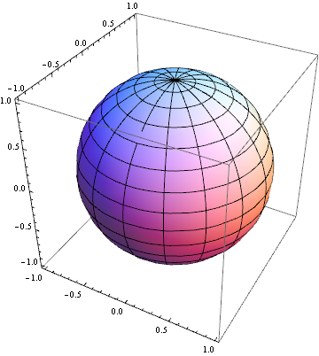
Constructing a 3-D reference model Earth
assigning chemical and physical states to Earth voxels

Slide 23
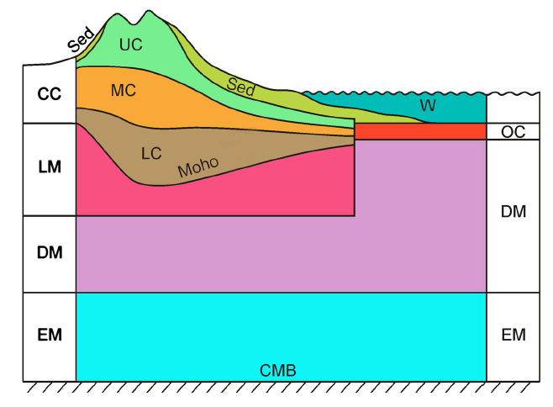
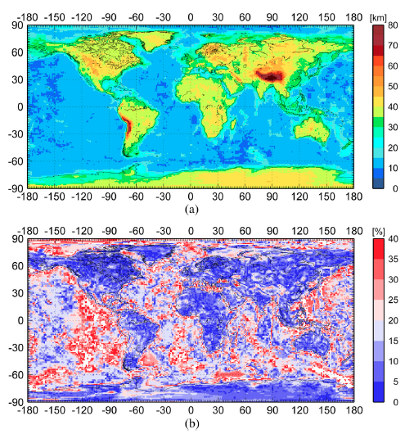
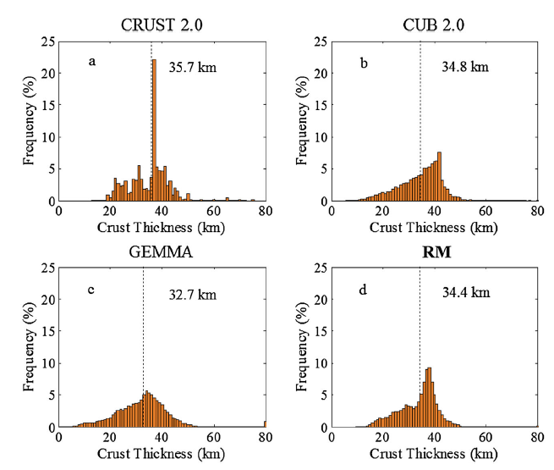
Huang et al (2013) G-cubed
Global Earth Reference Model
7 layers for the top 200 km
Integrate 3 global models for the crust
New crust model with uncertainties

Slide 24
Uranium Abundance in Middle Continental Crust layer
U_{MCC} (μg/g)
Average middle Cont. Crust U abundance is μg/g
Rudnick and Gao (2003) Treatise of Geochemistry 1.3 μg/g

Slide 25
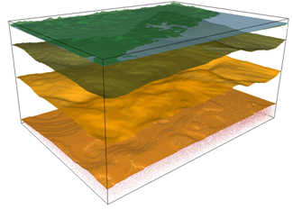
Geological model – Continental Crust
U
(ppm)
Upper crust
2.7
Middle crust
1.0
~35km
Lower crust
0.16
Upper mantle
Moho
0.01
crust – mantle
boundary
Surfaces of each layer is defined by geophysical data (i.e., gravity and seismic)

Slide 26
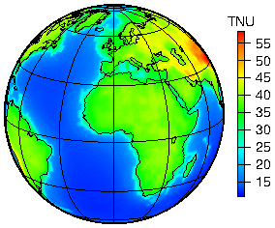
Predicted Global geoneutrino flux based on our new Reference Model
Huang et al (2013) G-cubed, 14:6, doi:10.1002/ggge.20129

Slide 27
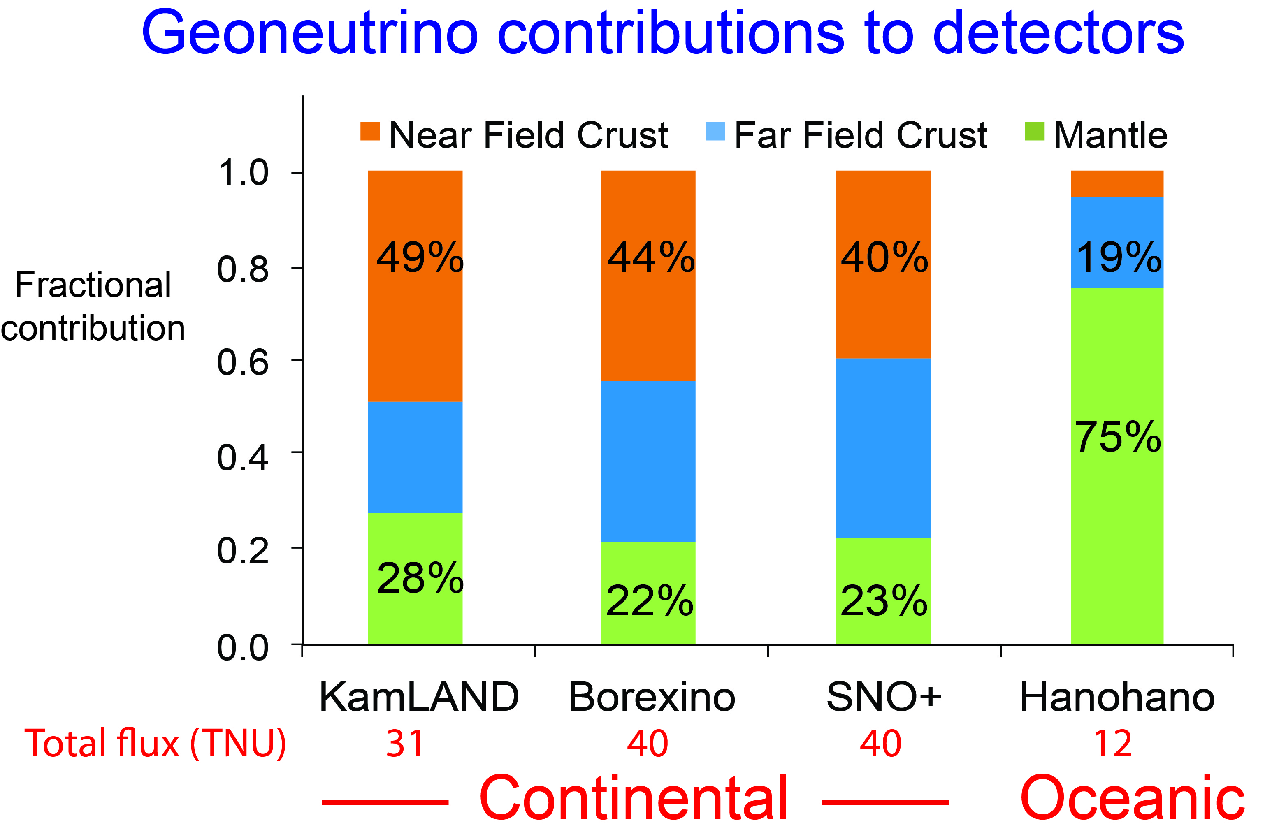
Near Field: six closest 2° × 2° crustal voxels
Far Field = bulk crust – near field crust

Slide 28
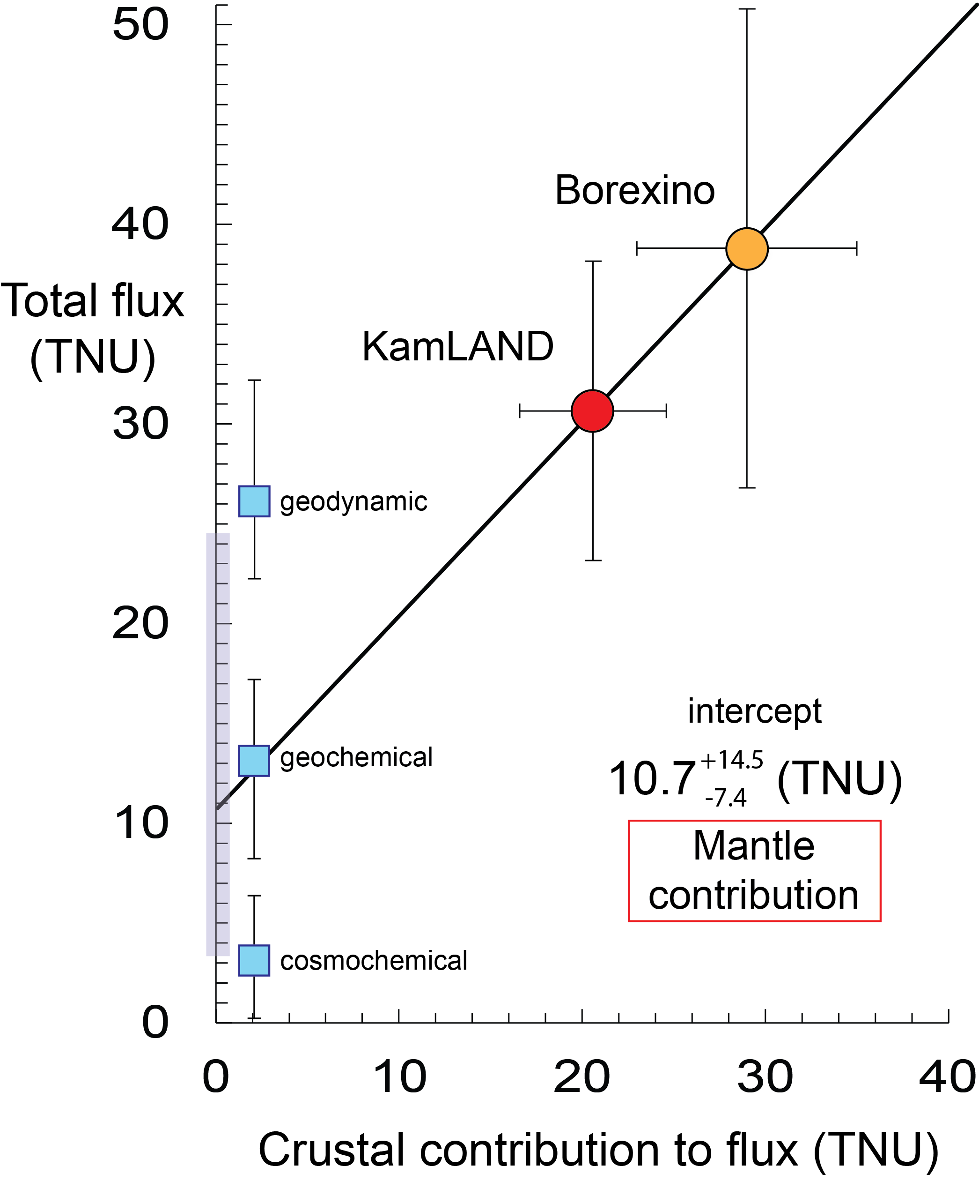
Existing data
squeezing @ limit
coincidences of intercepts
Y-axis data is strictly from physics
X-axis data is strictly from geology
Intercept is mantle contribution

Slide 29
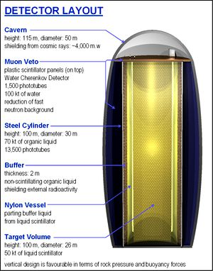
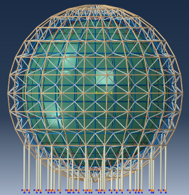
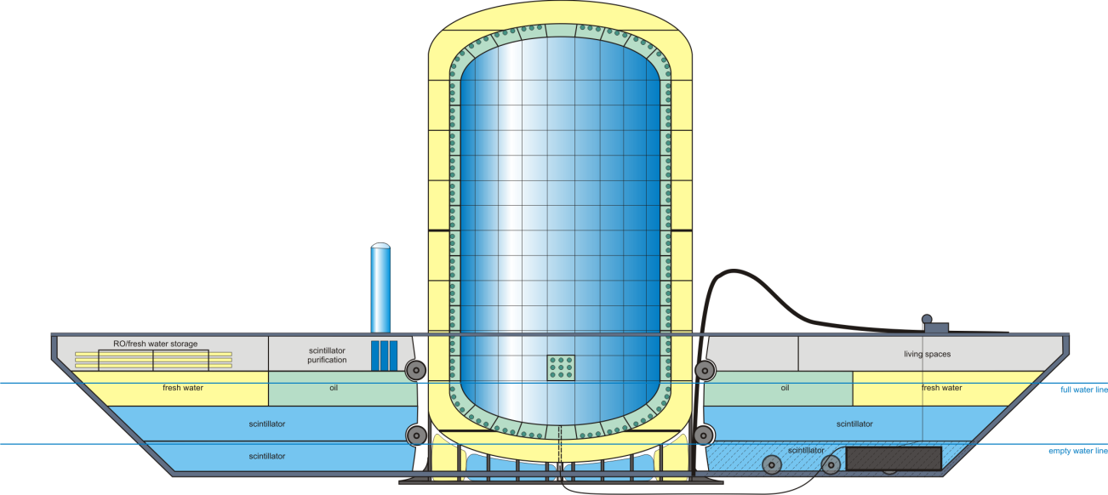
Future
detectors?
LENA,
EU
(50kt)
JUNO
China
(20kt)
Hanohano
International
ocean-based
(10kt)

Slide 30
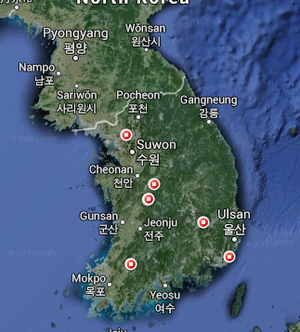
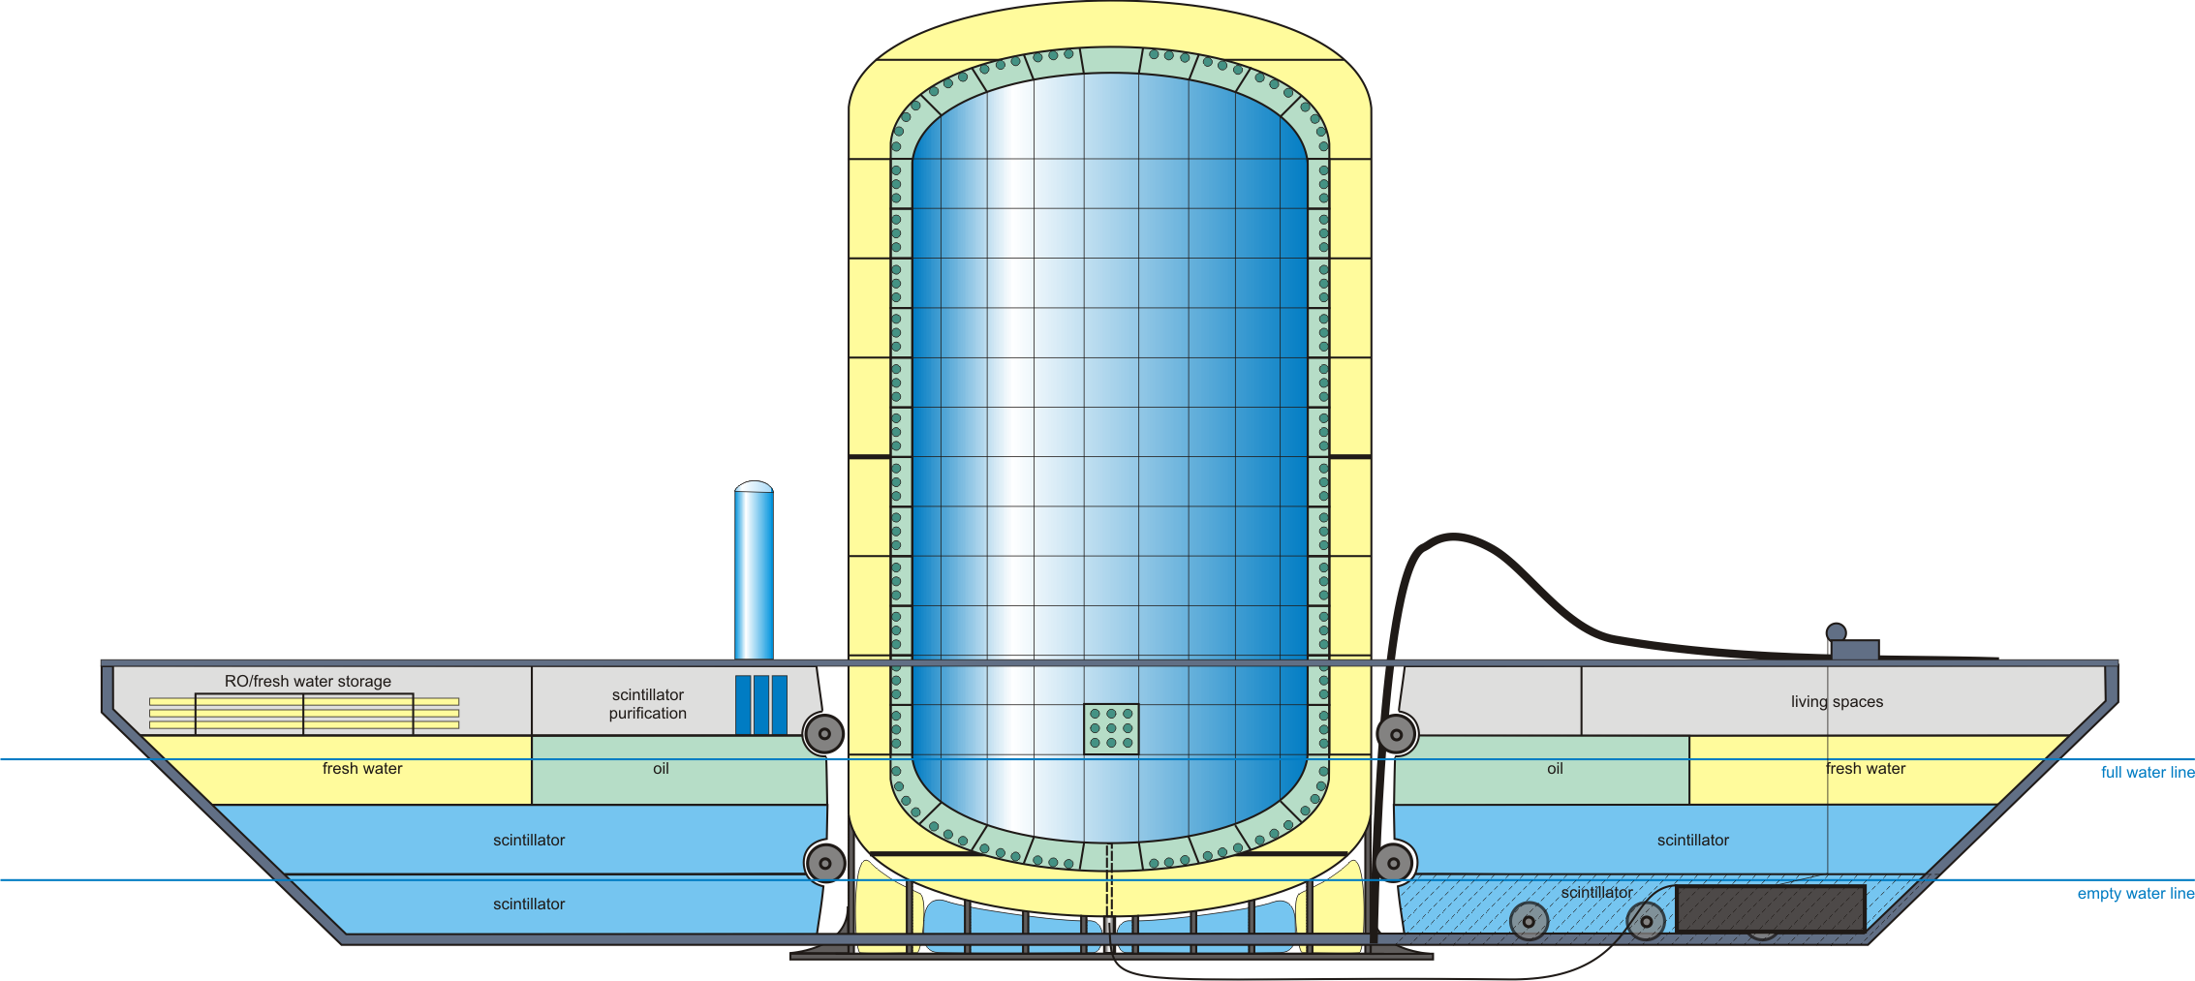
Korean Underwater
Neutrino Observatory
Physic Goals
Mass hiearchy
Proton Decay
Oscillation mixing
Future sight of KUNO?
Geology Goals
Th & U abundance
Thermal evolution
In addition, the instrument can be used for Nuclear Monitoring Goals

Slide 31
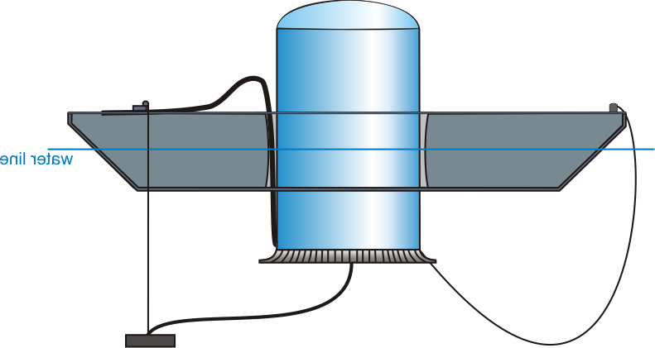
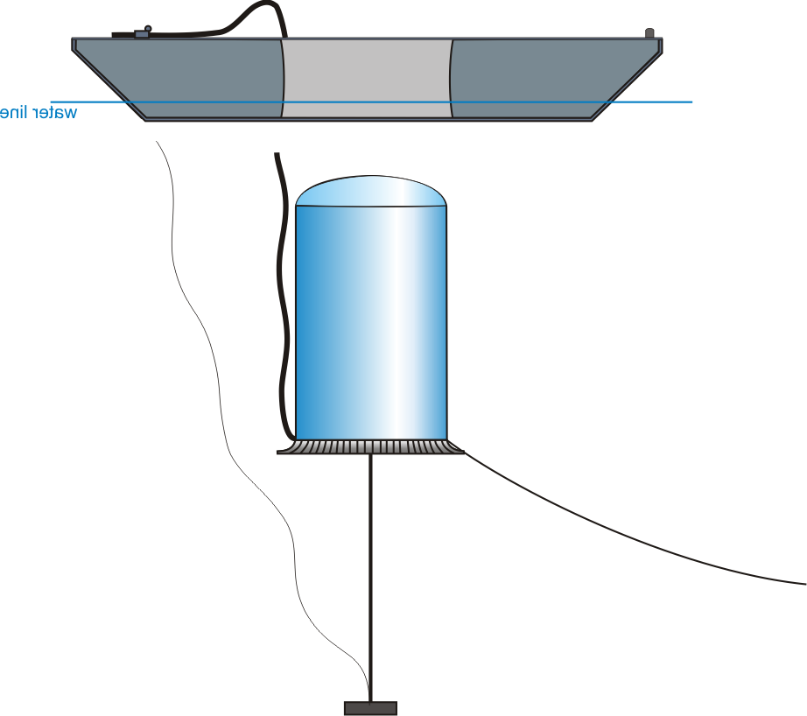
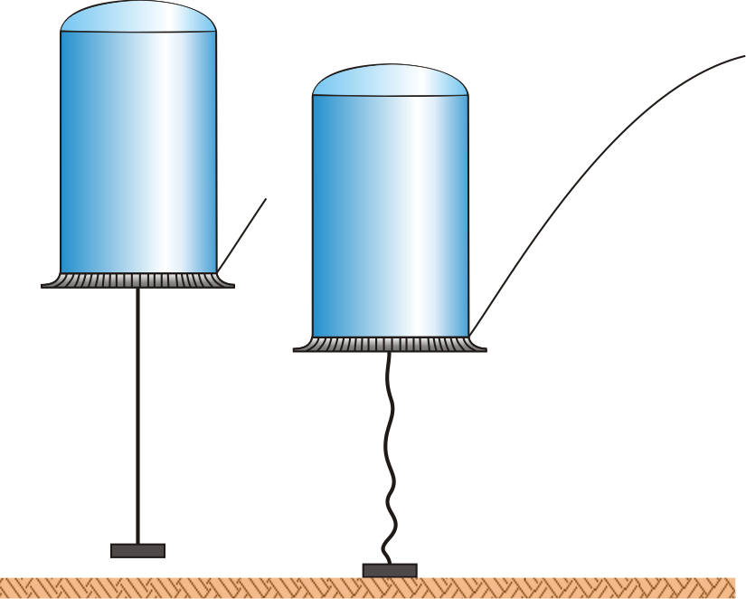
Hanohano
An experiment with joint interests in Physics, Geology, and Security
Size: scalable from 1 to 50 kT
10-yr cost est: $250M @ 10 kT
multiple deployments
deep water cosmic shield
control-able L/E detection
A Deep Ocean
ν_{e} Electron
Anti-Neutrino
Observatory
Deployment Sketch
Descent/ascent 39 min

Slide 32
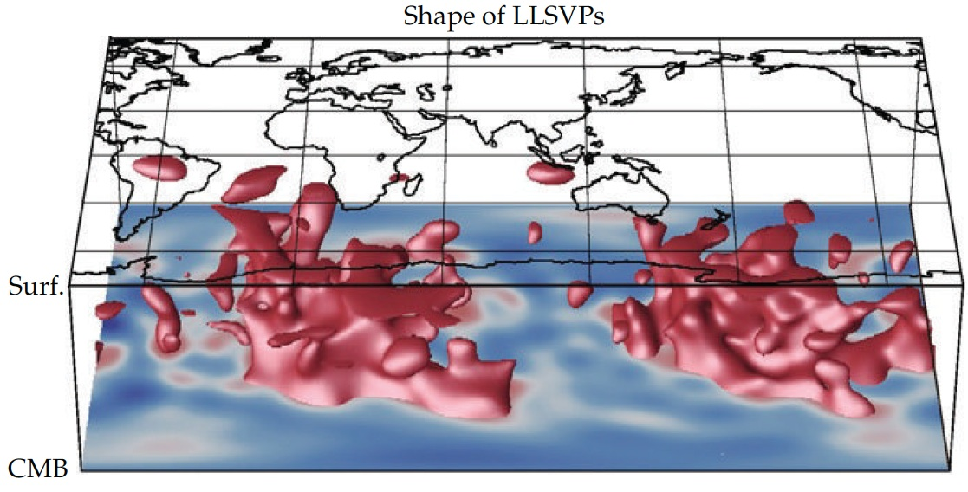
What’s hidden in the mantle?
Seismically slow “red” regions in the deep mantle
Can we image it
with geonus?
From Alan McNamara after
Ritsema et al (Science, 1999)

Slide 33
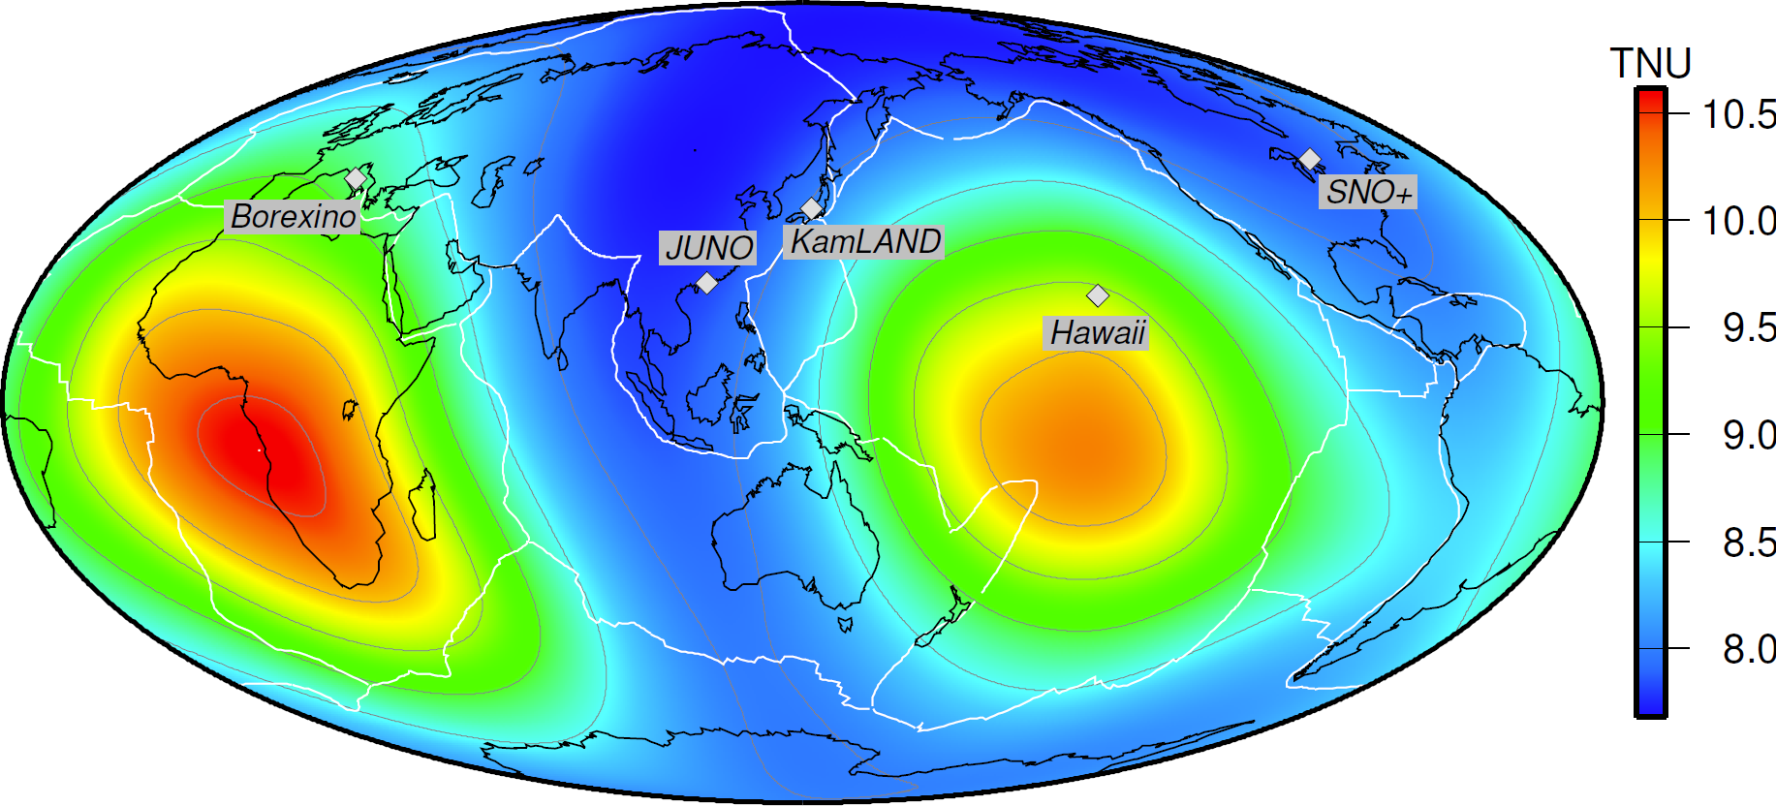
Testing Earth Models
Mantle geoneutrino flux (²³⁸U & ²³²Th)
Šrámek et al (2013) EPSL, 361: 356–366, 10.1016/j.epsl.2012.11.001

Slide 34
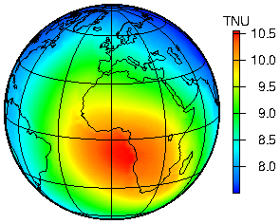
Predicted geoneutrino flux
Total flux at surface
dominated by Continental crust
Yu Huang et al (2013) G-cubed 10.1002/ggge.20129
Mantle flux at the Earth’s surface
dominated by
deep mantle structures
Šrámek et al (2013) EPSL 10.1016/j.epsl.2012.11.001

Slide 35
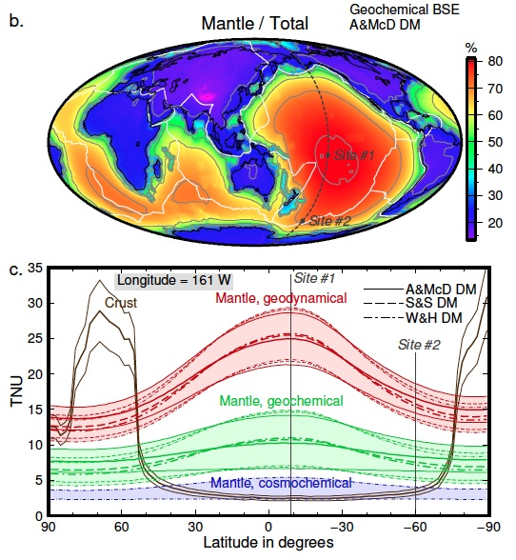
Ocean based experiment!
Neutrino Imaging
- Pacific Transect
Avoid continents
4 km depth deployments
Map out the Earth’s interior
Test Earth models
Šrámek et al (2013) EPS, 10.1016/j.epsl.2012.11.001

Slide 36
SUMMARY
Earth’s radiogenic (Th & U) power
22 ± 12 TW - Borexino 11.2 TW - KamLAND
Prediction: models range from 8 to 28 TW (for Th & U)
On-line and next generation experiments:
SNO+ online 2015 ☺
JUNO: 2020, good experiment, big bkgd, geonu …
Hanohano: this is FUNDAMENTAL for geosciences
Geology must participate & contribute to the cost
Future:
Neutrino Imaging of Earth’s deep interior ☺
+ 7.9
- 5.1

Slide 37
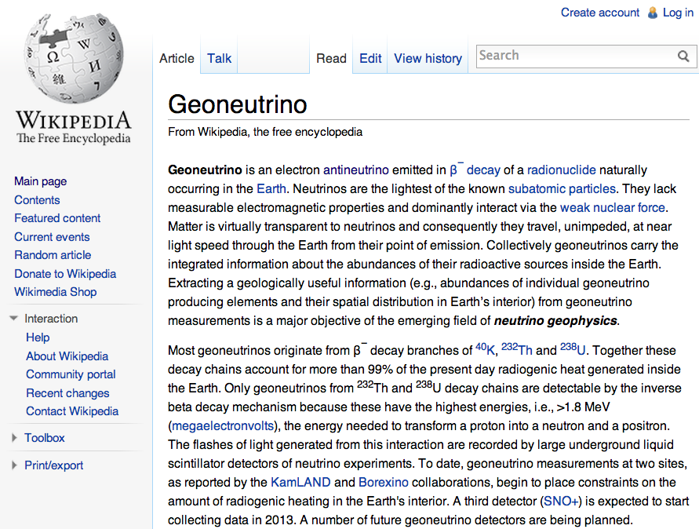
Geoneutrinos: ongoing efforts and wish list
- Directionality
- ⁴⁰K geonus
- Detecting hidden objects in the Earth
Out-reach efforts

